Slide 1
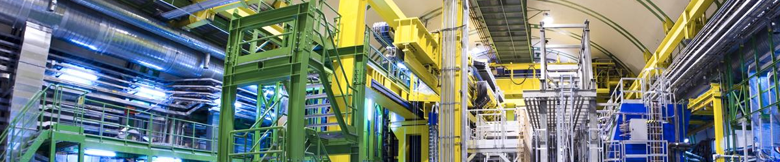
Status of the LHCb Experiment
Installation, commissioning and prospects of early physics
Rolf Lindner
CERN, Geneva, Switzerland
On behalf of the LHCb Collaboration
1
1
Notes:
1

Slide 2

Introduction
~ 50 institutes in 16 countries are participating in the LHCb project
~ 700 collaborator
The aim of the LHCb experiment is to search for New Physics through the
study of CP violation in B decays with the precise determination of the CKM parameters
search for rare B-decays
2
2
Notes:
2

Slide 3
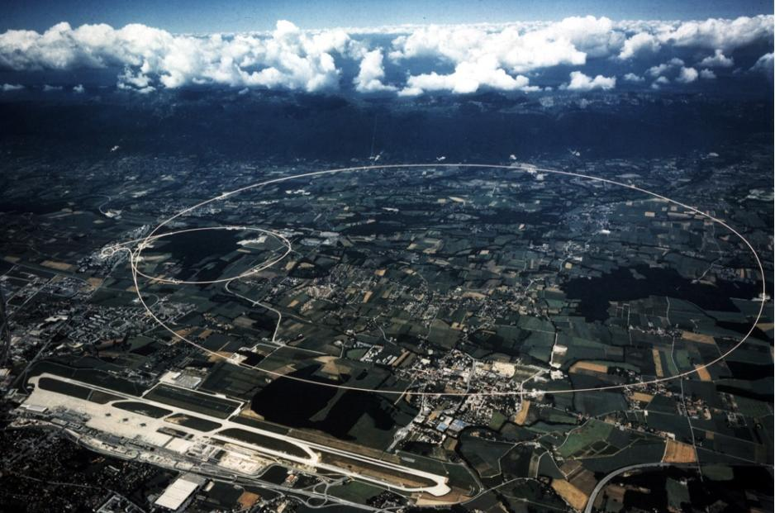
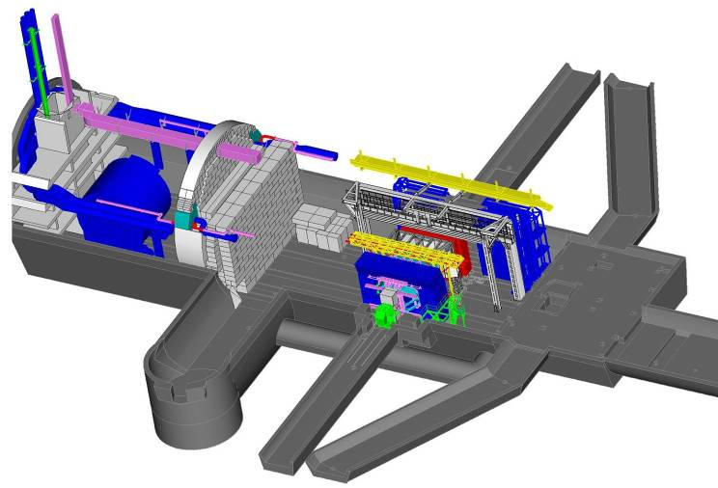





Introduction
Proton beam
Shielding wall
(against radiation)‏
Cavern ~100m below surface
Electronics
+ CPU farm
Detectors can be moved
away from beam-line
for access
Offset interaction point (to make best use of existing cavern)‏
3
Proton beam

Slide 4
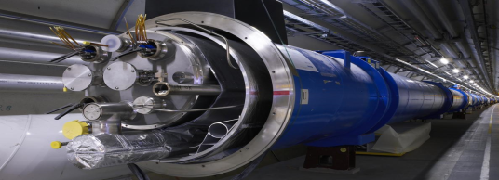
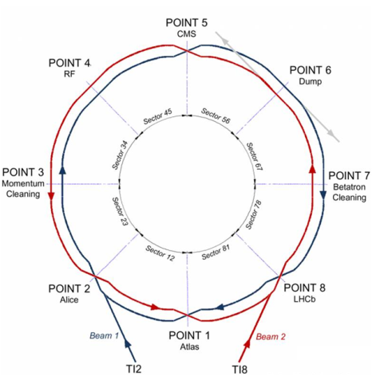
Introduction
The LHC
LHC design parameters
  Ring circumference [m] 26658.883
  Proton-Proton Collisions
  Center-of-mass energy: 14 TeV
  Total cross-section close approx. 100mb
  Design peak Luminosity 10³⁴ cm⁻²sec⁻²
  Number of particles per bunch 1,15 x10¹¹
  25ns bunch crossing time
  2808 bunches per beam
  Stored energy: 360 MJ per beam

Slide 5
Introduction
Luminosity & energy of colliders
The LHC
x 7
x 100

Slide 6
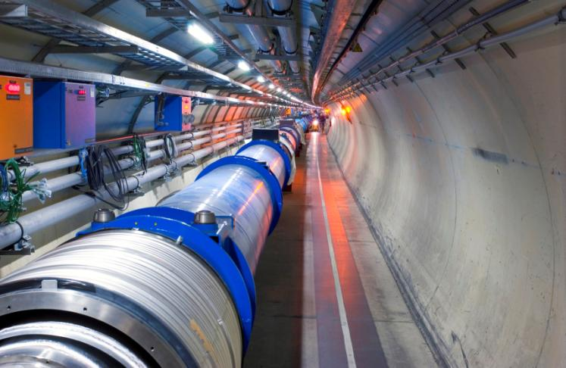
Introduction
The LHC
23 km of superconducting magnets
1232 dipoles, 474 quadrupoles, 7612 correctors

Slide 7
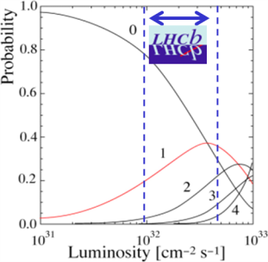
Notes:
7

Slide 8
Introduction
To reach the given targets the detector has to meet the following requirements:
efficient trigger for many B decay topologies
  Muon System, ECAL+Preshower , HCAL, Vertex Locator
efficient particle identification
  RICH
good decay time resolution
  Vertex Locator
good mass resolution
  Tracker and Magnet
Muon System
Calorimeter
RICH 2
p
p
Outer/Inner
Tracker
8
8
Notes:
8

Slide 9
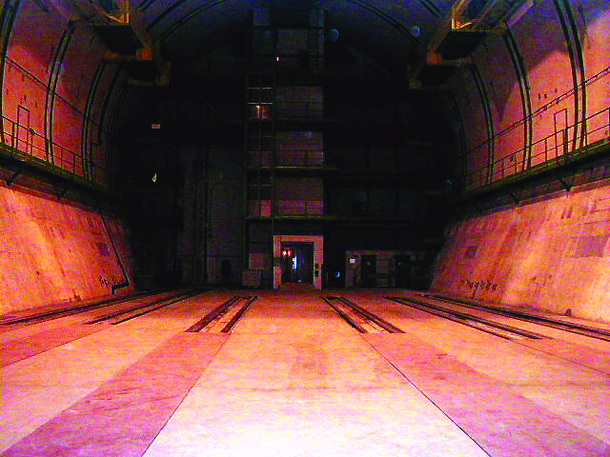
Introduction
LHCb Technical Proposal approved September 1998
Start of installation November 2002 with the magnet support.
Technical Design Reports submission:
  Magnet April 2000
  Calorimeters September 2000
  RICH September 2000
  Muon System May 2001
  VELO May 2001
  Outer Tracker September 2001
  Online System December 2001
  Inner Tracker November 2002
  Reoptimized Detector September 2003
  Trigger System September 2003
  Computing June 2005
9

Slide 10
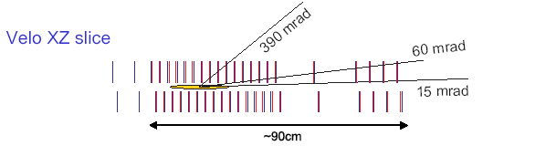
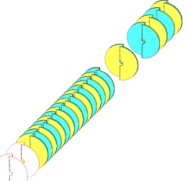
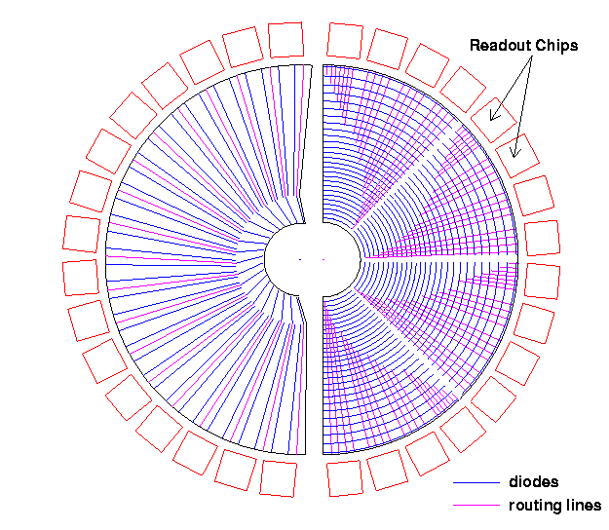
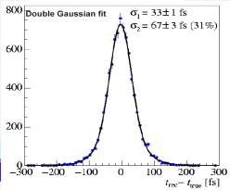
Vertex Locator
IP8
360 mrad
21 stations
Each station measures R and Phi
Left-Right staggered in Z to allow for overlap
p
~1m
Retractable by 30 mm
r-sensors
4x45º sectors
2048 strips
Pitch: 40 to 100 µm
φ-sensors
10º-20º stereo angle
Inner and outer region
2048 strips
Pitch: 35 to 100 µm
p
42 mm
B-Vertex Measurement
35
78
39
97 um
pitch
8 mm
Example: Bs → Ds K
47 μm
144 μm
K⁺
σ(τ) ~40 fs
Primary vertex
K⁺
B_{s}
D_{s}
K⁻
π⁻
d≈1 cm
Decay time resolution = 40 fs
10
10
Notes:
10

Slide 11
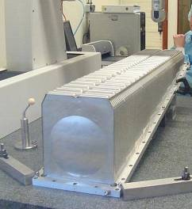
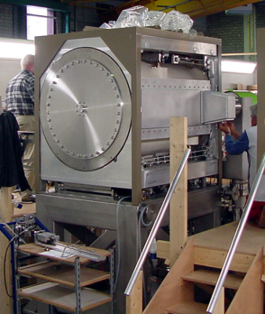
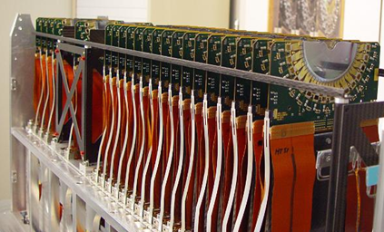
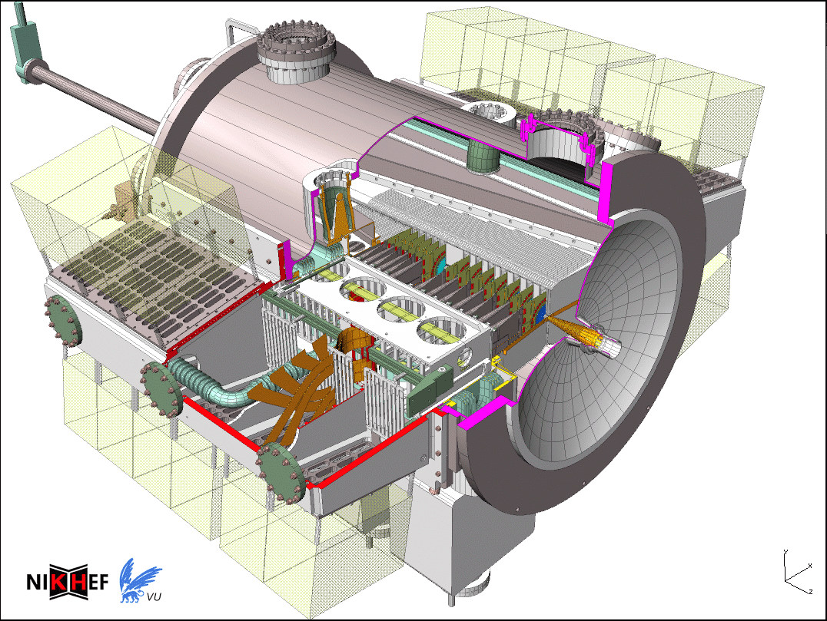
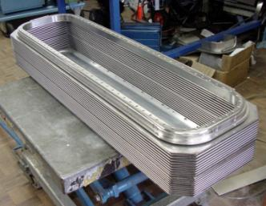
Vertex Locator
Detector vacuum box
AlMG3 300µm
Detector Modules
Rectangular bellow
Custom-made
11
11
Notes:
11

Slide 12
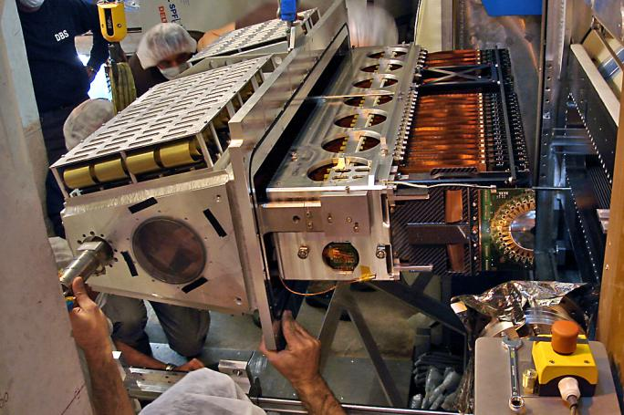
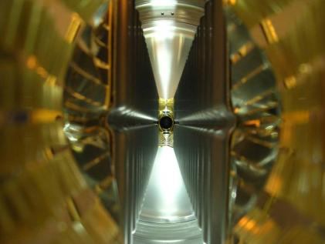
Installation of one half of the VELO detector sensors.
View of the beam through the VELO in direction of the experiment.
12

Slide 13
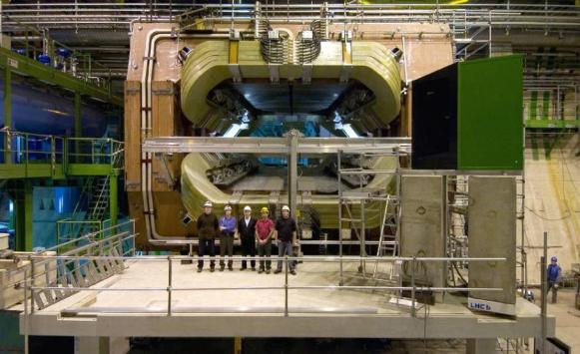
Dipole Magnet
Installed in October 2004 followed by commissioning and field map measurements.
B_{y} [T]
dB
B
---- = 10⁻⁴
measured
Conductor Warm, Al
Integrated field 4 Tm (10m)‏
Peak field 1.1 T
Weight 1600 tons
Consumption 4.2 MW
simulation
Z [cm]
13
13
Notes:
13

Slide 14
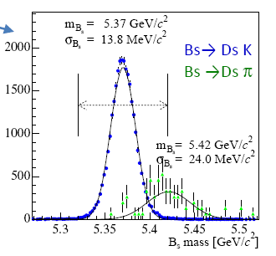
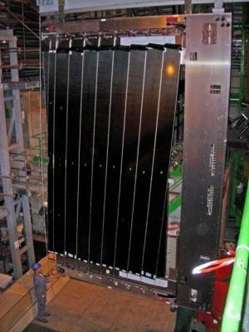
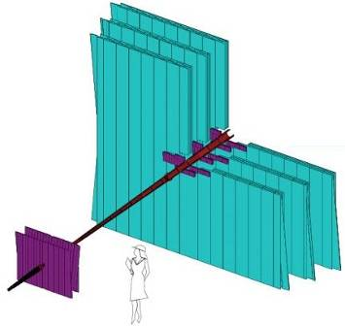
Tracking,
Outer Tracker
Mass resolution
σ ~14 MeV
π⁺,K⁺
B_{s}
K⁺
3 stations, each with
4 double layers (0º, +5º, -5º, 0º)
5 mm ∅ straw tubes
Gas: Ar/CO₂ (70/30)‏
D_{s}
K⁻
π⁻
Primary vertex
b^{tag}
0.34m
Outer Tracker
5mm straws
e⁻
Track
e⁻
e⁻
Inner Tracker
pitch 5.25 mm
e⁻
e⁻
Trigger
Tracker
14
14
Notes:
14

Slide 15
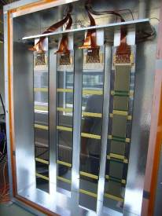
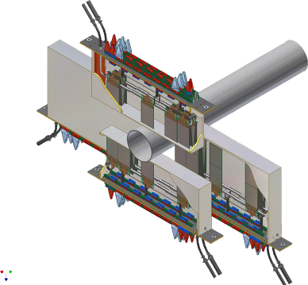
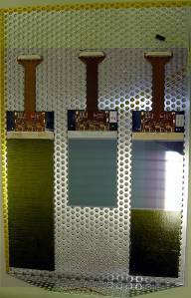
Tracking
Silicon Tracker
Tracker Turicensis Silicon sensors:
4 detection layers (0°/+5°/-5°/ 0°)‏
500 μm thick
~ 8.2 m², 896 silicon sensors,
280 r/o sectors, 143k r/o strips
91.57 mm long, 183 μm pitch
Inner Tracker Silicon sensors:
4 boxes per station
320 μm for 1-sensor ladders
410 μm for 2-sensor ladders
~ 4.2 m², 504 silicon sensors,
336 modules, 130k readout strips
108 mm long, 198 μm pitch
2% of area
20% of tracks
15
15
Notes:
15

Slide 16
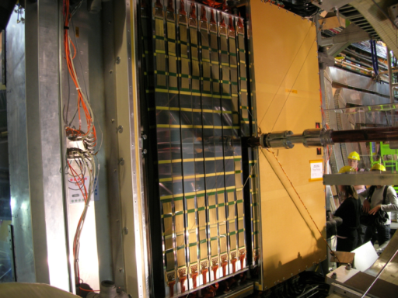
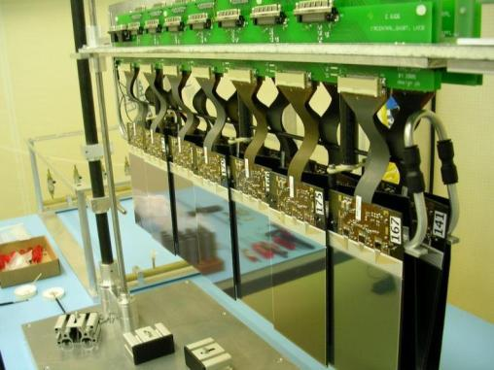
Tracking
Silicon Tracker
Inner tracker modules
Tracker Turicensis, one side with cover
16

Slide 17
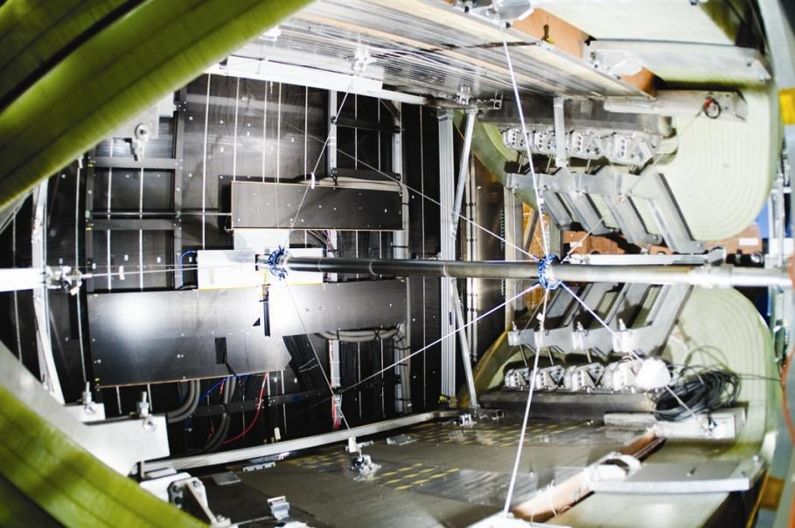
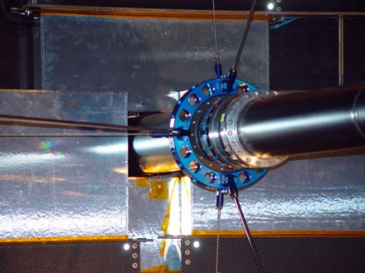
Outer and Inner Tracker, seen through the magnet
Outer Tracker/inner
Fully installed
17

Slide 18
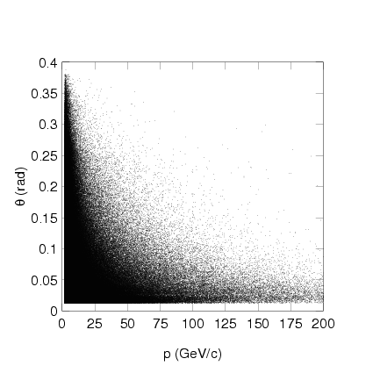
RICH Detectors
Two Cherenkov detectors (RICH) for charged hadron identification
⇒ excellent π–K separation for momenta up to 100 GeV/c
π–K separation
All charged tracks in b-events
18

Slide 19
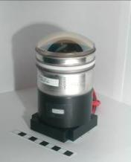
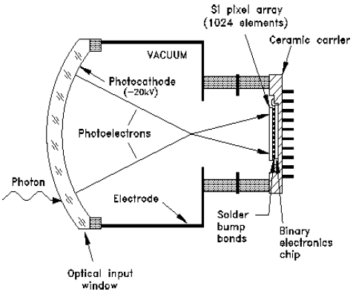
RICH Detectors
Cherenkov light is read out by Hybrid Photon Detectors (HPD)‏
Pixel HPDs developed in collaboration with industry (Photonis- DEP lead partner)‏
Vacuum tube with silicon pixel readout
75 mm active diameter
484 HPDs to meet the requirements
Factor 5 demagnification @ 20kV
Encapsulated electronics:
  8192 pixels logically OR-ed in groups of 8 to form
a matrix of 32 x 32
  binary output of 1024 channels
80mm
120mm
19

Slide 20
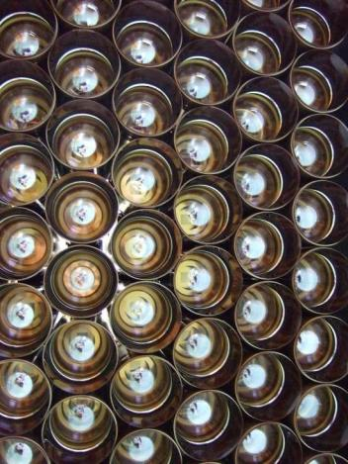
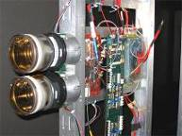
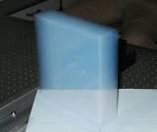
RICH 1
Two radiators
Aerogel
C4F10
π/K separation
2→10 GeV/c
up to 70 GeV/c
n
1.03
1.0014
Hybrid photon detector (HPD).
A full HPD plane
Seal to the Vertex
Beam Pipe
Aerogel
Spherical Mirrors
Plane Mirrors
Acceptance:
25→250 mrad (vertical)
300 mrad (horizontal)‏
20
20
Notes:
20

Slide 21
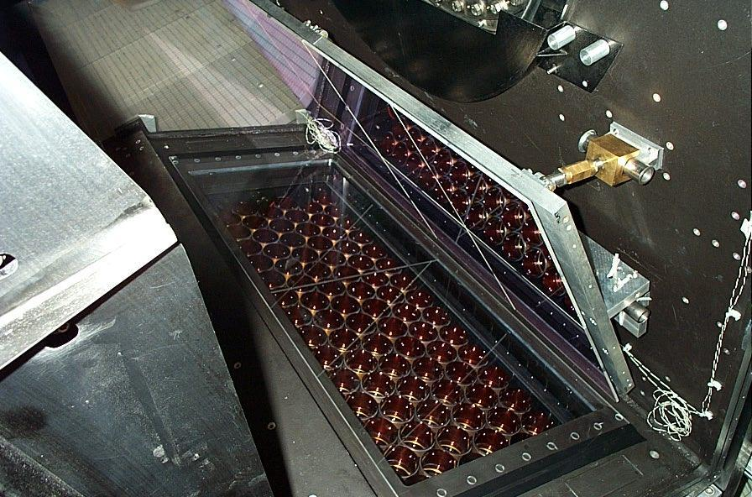
Inside of RICH 1 gas enclosure, Quartz window, HPD and mirror
21

Slide 22
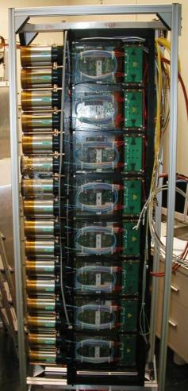
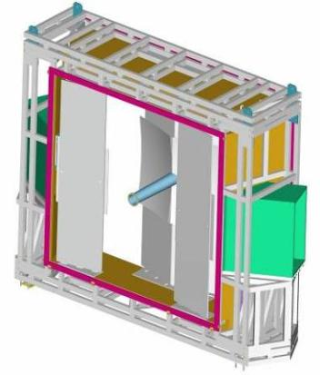
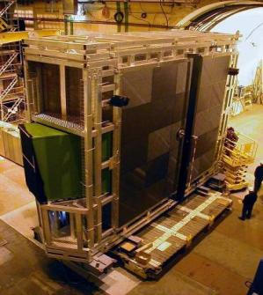
RICH 2
Acceptance:
15→100 mrad (vertical)‏
15 →120 mrad (horizontal)‏
Radiator
CF₄ → ≥ 100 GeV/c
n =1.0005 (at 400 nm)‏
Volume: ~ 100m³
Flat mirrors
Spherical Mirrors
Support Structure
Central Tube
RICH 2 transport inside the exp. cavern
One HPD column of RICH
Photon Funnel + Shielding
22
22
Notes:
22

Slide 23
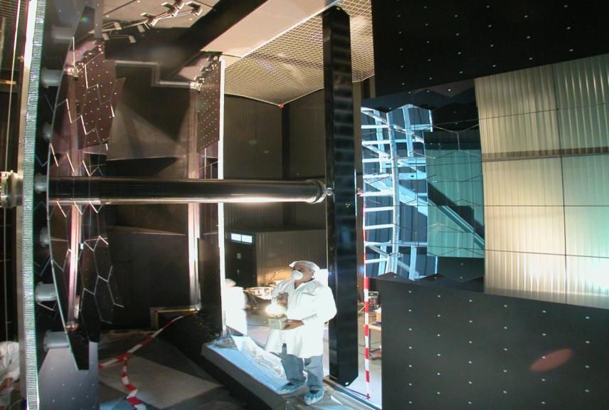
View from inside the RICH 2
Spherical mirrors
Central tube
Plane mirrors
23

Slide 24
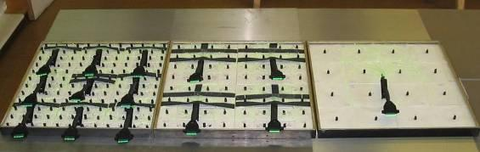
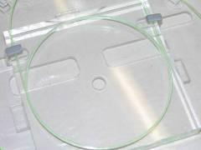
Calorimeter,
PreShower & Scintillator Pad Detector
2.5 X₀ lead converter sandwiched between
two scintillator planes each with 5952 scintillating pads with thickness of 15 mm
Cell design: 40x40 mm², 60x60 mm², 120x120 mm²
SPD/PS modules
HCAL
ECAL
Inner
Middle
Outer
PS/SPD
Scintillation light is transmitted to a photo-Multiplier by fibres
Scintillating tile
Here shown with glued fibre
24
24
Notes:
24

Slide 25
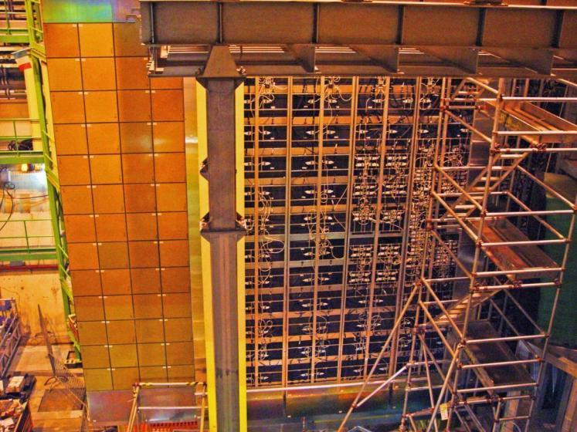
Calorimeter,
PreShower & Scintillator Pad Detector
Preshower and SPD in an open position
PreShower
Lead
Sintillator Pad Detector
25

Slide 26
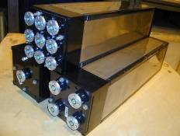
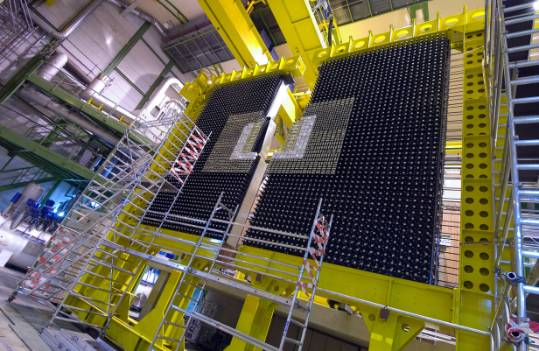
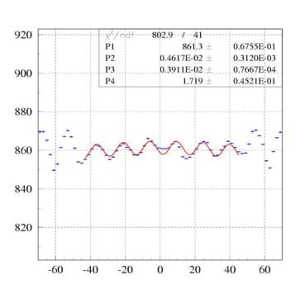
Calorimeter, Electromagnetic
Segmented in three sections with 9, 4, 1 cell(s)‏
5952 channels, 25 X₀ “shashlik” type modules
66 layers of 2mm Pb/ 4mm scintillator
Scintillation light is read out with phototubes through fibre bunches.
Non-uniformity of response,
50 GeV e-beam parallel to the module axis
A_{global} = 0.46 ± 0.03%
A_{local} = 0.39 ± 0.01%
mm
Energy resolution :
(9.4±0.2)%/√E ⊕(0.83±0.02)%
26
26
Notes:
26

Slide 27
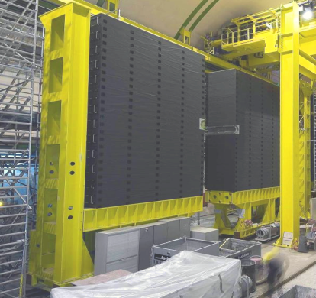
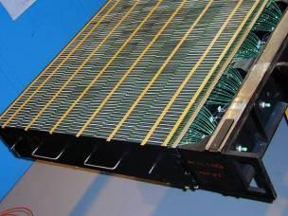
Calorimeter, Hadronic
Sampling device made from Fe + scintillating fibres
52 modules, 1468 channels, longitudinal-tiles, 5.6 λ_{l}
6mm master/4mm spacer, 3mm scintillator
spacers
particles
scintillators
WLS
fibers
master plate
light guide
PMT
Beam direction
25ns
A pulse shape study on 30 GeV electron beam for 6 different layers in depth of the HCAL:
25 ns pulse shaping
27
27
Notes:
27

Slide 28
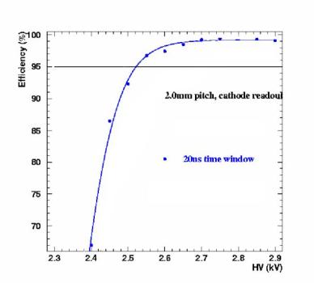
Muon System
5 stations (M1-M5), each with four regions(R1-R4)‏
435 m² Detector area
1368 MultiWireProportionalChambers
4-gap chambers in M2-M5. 2-gap in M1 (R2-R4).
24 3-GEM (M1, R1) 0.6m²
Gas mixture:
MWPC: Ar/CO2/CF4 (40/55/5)
Triple-GEM: Ar/CO2/CF4(45/15/40)‏
Cathode Efficiency
MWPC
WP
The logical OR of the two
double gaps ensures that ε > 99.8% per station will be reached.
Muon Stations
-> Plateau length is about 350 – 450 V
28
28
Notes:
28

Slide 29


Muon System
Muon station with MWPC in a closed position
GEM
29
29
Notes:
29

Slide 30




Metal foil detector and Beam Condition Monitor
Metal foil detector
On-line measurements of the radiation dose absorbed by
Si-sensors of the Inner Tracker
The system is based on the Metal Foil Detector (MFD) technology and utilizes the Secondary Electron Emission (SEE):
The SEE generates a positive charge on the foil, integrated by a sensitive Charge Integrator (ChI).
Beam Condition Monitor
Protection against possible adverse LHC beam conditions, particular with hadronic showers caused by misaligned beams or components.
8 CVD diamond sensors symmetrically distributed around the beam pipe.
BCM-U at 2130 mm upstream of IP, inner radius of sensitive area: 48 mm
BCM-D at 2765 mm downstream of IP, inner radius of sensitive area: 36 mm
30

Slide 31






Beam Pipe
The beam pipe design is particularly delicate since the LHCb experiment is focused on the high rapidity region.
Shape: Conical
Material: Beryllium for the first 12 m, Stainless Steel for the remaining 7 m, Aluminium alloy for the VeLo exit window.
Delivery to CERN October ‘05
UX85/2: Be beam pipe with the aluminum bellows inside transport protection
31
31
Notes:
31

Slide 32

Beam Pipe
Beam Pipe
32

Slide 33

Beam Pipe
RICH 2
Inox beam pipe
Be beam pipe
Muon
LEAD and SPD
PS
ECAL
HCAL
33

Slide 34


Two-level Trigger
40 MHz
Level 0
Custom Electronics
  Fully synchronous (40MHz)‏
  4 μs fixed latency
Pile-up Syustem ⊕ High p_{T} candidates
  from Calorimeter (e, γ, π⁰, hadron)‏
  and Muon system (μ, μμ)‏
Hardware based
1 MHz
High Level Trigger
PC farm of ~2000 CPUs
  Full detector information available
  Only limit is CPU time
First uses tracking information to confirm L0 objects ⊕ optional IP Cut
  ≠ alleys: rate reduced to ~30kHz
Then build inclusive and exclusive selections: full event reconstruction
Software based
~2kHz
Storage: event size ~35kB
34

Slide 35


35

Slide 36
Commissioning
Strategy
Commissioning of each individual detector.
    Define first initial settings of time alignment, high voltage and other operating parameters. This work had been done in ‘local’ mode, working close to the detector with a “portable DAQ rack”.
  Commissioning of LHCb as a whole without beam.
    Form LHCb as a single experiment, instead of a collection of individual detectors.
    Exercise with full load on the system.
  Commissioning with beam, to insure a proper readout and trigger.
  Start with single beam at injection energy.
    Particles crossing the detector with a reasonable timing,
    Aligning the detector in space.
36

Slide 37

Commissioning
2nd July: CALO + Muons + OT + IT + TT
(cosmic events)‏
Muon
Muon
Calo
Calo
OT/IT
OT/IT
37

Slide 38



Commissioning
TED events (stop of Beam 2)‏
Muon tracks cross LHCb in the “wrong” direction
SPD (provided trigger)‏
LHCb sees tracks from the LHC injection tests on August 24
Muon chambers
VELO
(Run 30933, Event 14)‏

Slide 39



Commissioning
Beam 1: - 1 shot every 48 sec.
- 5×10⁹ protons per shot
10 September: Events taken during Beam 1
circulation look like either
low multiplicity events, or splashes
Top view
Muon
Side view
OT
Muon
Calo
Calo
OT
39

Slide 40
Commissioning
Initially , time and space alignment with cosmic data have not been considered because of the horizontal orientation of LHCb.
But it turned out that cosmic data together with muons originated from beam stopper at a distance of 300m in front of LHCb were very useful for the first alignment of sub detectors.
Time alignment
Muon cosmics & TED
Calorimeters cosmics
RICH TED
OT cosmics & particles from beam 1 splashes
ST cosmics & TED
VELO TED
  HCAL & ECAL trigger used for cosmic data
  SPD multiplicity and Muon triggers for the TED and Beam-1 data
40

Slide 41


Slide 42


Slide 43

Commissioning
Muon time alignment (using cosmic data taken on Sept.18)‏
Backward tracks
Shifted in time
Forward tracks
aligned
Calo Trigger:
Time alignment of ~3 ns observed for the forward tracks for all Muon stations
43
43

Slide 44




Commissioning
TDC spectra of all OT chambers
TDC range = 3 BX
Outer Tracker time alignment
(using 6 Beam1 splash events)‏
Drift time
Trigger
BX = n - 2
Run 33062:
6 events with ~50 tracks/event
BX = n - 1
45 ns
BX = n
BX = n + 1
44
44

Slide 45

Commissioning
Space alignment:
Strategy:
Internal alignment of sub detectors with cosmic data wherever possible.
Final alignment with long tracks reconstructed with VeLo and other tracking detectors
-> needs collisions (first attempts have been done using TED events)‏
Extrapolation of VELO tracks to IT (TED events)‏
Large combinatorial
background due to
very high multiplicity of
TED events: ~10 muon per cm²
45

Slide 46

Commissioning
TED events: Residuals in TT station
Distance of TT clusters to VeLo track for TT layers
    within ~300 micron of expected
46
46

Slide 47
Early physics
LHCb key measurements are potentially sensitive
to the discovery of New Physics
In CP – violation
  φ_{s}
  γ in trees
  γ in loop
In Rare Decays
  B → K*μμ
  B_{s}→ μμ
  Polarization of photon in radiative penguin decays
47

Slide 48


Early physics
LHCb prospects: φ_{S}
B⁰_{s} mixing phase φ_{s} is very small in the SM
  φ_{s}SM = –0.037 ± 0.002 (UT fits)
  Could be much larger if New Physics contribution in the box diagram,
  → φ_{S} = φ_{S}(SM) + φ_{S}(NP)
Golden b→ccs mode is B⁰_{s}→ J/ψφ:
  High BR ~ 3x10⁻⁵ and good exp. Signature (μ trigger effective)‏
  Expect ~130k B_{s} →J/ψ(μμ) φ signal events / 2fb^{–1}
  B_{bb}/S= 0.12
  Angular analysis needed to separate CP-even and CP-odd contributions
  Combine CDF and DØ: φ_{S} = -2.36 + 0.37 - 0.29,
  July 25, 2008; approved by CDF, D0 -0.77 + 0.29 - 0.37
0.03
48

Slide 49



Early physics
LHCb prospects : B_{s} → μμ
Very small BR in SM
(3.4 ± 0.5) x 10⁻⁹
This decay could be strongly enhanced
in some SUSY models.
Current limit from CDF
BR(B_{s}→μμ) < 4.7×10⁻⁸
LHCb
49

Slide 50

Conclusion
LHCb is a heavy flavour precision experiment searching for New Physics in
CP Violation and Rare Decays
After more than 10 years of prototyping, production and construction, the LHCb experiment has been installed and commissioned.
First tracks have been seen
  Cosmic events
  During the LHC beam synchronization tests
  With first circulating beams at 450 GeV
Very interesting results will come already with the first 0.5 fb⁻¹ of data:
  B_{s}→ J/ψφ Measurement of φ_{s} with σ(φ_{s})~0.06
  B_{s}→ μμ BR limit down to SM value
50
50
Notes:
50

