Slide 1
Production of heavy quarks and quarkonia at LHC(b)
Vanya Belyaev (ITEP/Moscow)

Slide 2
Outline
Heavy quark and quarkonia production
Why?
LHCb experiment
Open charm D⁰ D⁺ D_{s} Λ_{c}
Hidden charm J/ψ ψ’ χ_{c}
Associative charm 2×J/ψ J/ψ+C 2×C Z⁰+C
Bottomonia ϒ
Next steps and conclusion

Slide 3
Heavy quarks & QCD
HQ is likely the most powerful tool for quantitative study of QCD: α_{s}(m_{Q}), Λ_{QCD}/m_{Q}, ….
Why one needs to know QCD ?
All mass of visible Universe is due to QCD
Higgs takes care only on O(1%) of proton mass
All fundamental quantities are affected by QCD corrections.
The precise extraction is not possible without deep understanding of QCD
Dominant source of systematic for Higgs properties
strong CP-problem
QCD effects could nicely mimic New Physics: DPS
….

Slide 4
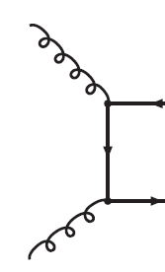
HQ and quarkonia production
For high energy proton-proton collision (LHC)
Mainly gluon–gluon fusion
Contribution for other sources is small
Simple?
Long and rich history, experimental and theoretical
End of XX-century @ Tevatron:
DATA/theory ›› 10
Some improvements around mid 2000
Becomes clear that the pattern is not so simple….

Slide 5
Some old slide: 2005

Slide 6
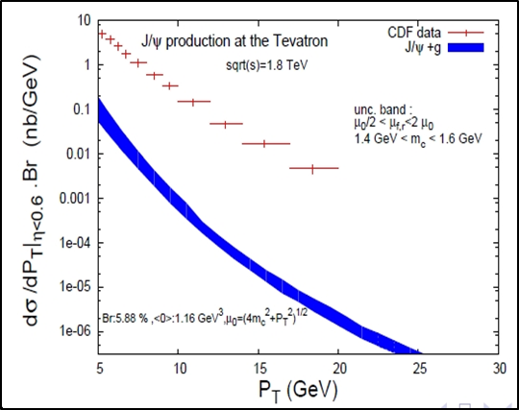
Another example J/ψ&ϒ @Tevatron
J.P.Lansberg

Slide 7
Progress with theory

Slide 8
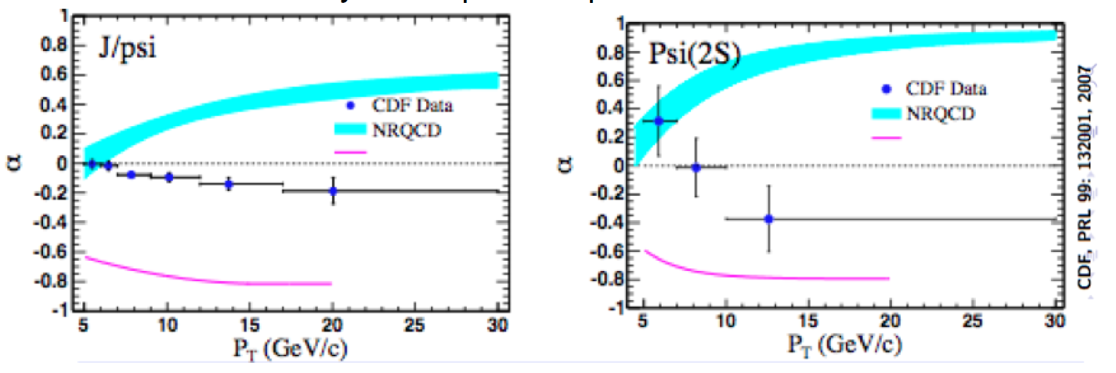
And what now?
Almost 20 years of continuous progress
Great improvement between experiment and theory for cross-sections.
Everything understood?
Warning bell!

Slide 9
Polarization fiasco
Reconsider the role of various mechanisms?
k_{T}-factorization?
Importance of feed-down ?
Important to compare J/ψ and ψ’
Important to know production of P-wave states
More data needed
Other observables: 2×J/ψ, quarkonia in pPb, J/ψ+C, J/ψ+ϒ,….. may shed light on the problem
LHCb is trying to attack all these targets..

Slide 10
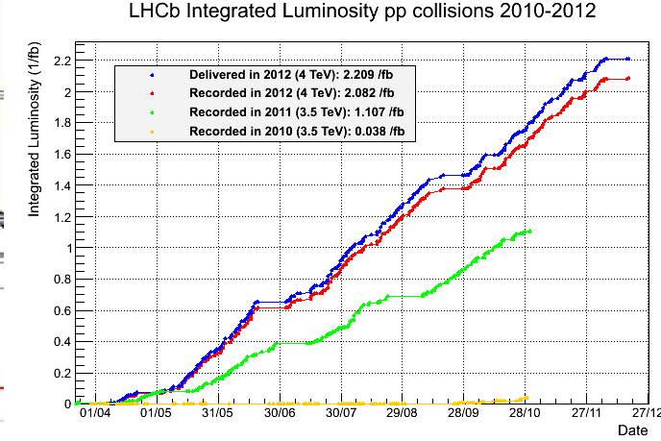
LHCb Experiment
1057 members
67 institutes
16 counties
2 groups from PRC
Tsinghua
CCNU
2<η<5
4% of solid angle
40% of HQ
pp-collisions
√s = 0.9, 2.76, 7 & 8
(13++ in 2015)
pA and Ap

Slide 11
Trigger & Selection
Very flexible trigger, down to low-p_{T} particles
Hardware: energetic (di)muon, hadron, e± or γ
Software: full reconstruction & particle ID
Typical efficiency for 2μ states >70%, for hadronic states ~30%
Offline:
Refine reconstruction, track quality, particle ID, good common vertices,
For open charm and beauty exploit finite lifetime and require vertex separation

Slide 12
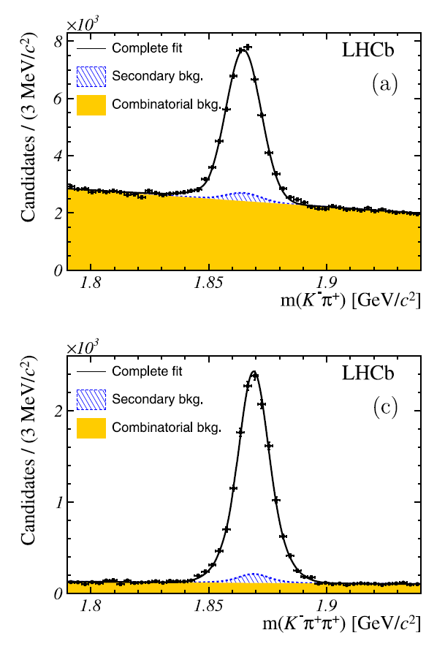
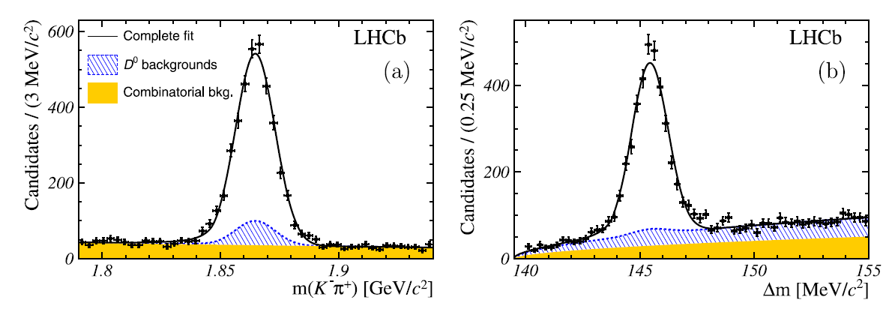
Prompt open charm D⁰,D^{*+},D⁺
NPB 871(2013) 1
“Early” measurement
only 15nb⁻¹
5×10⁻⁶ from full dataset
Contribution from b→c decays
D⁰ →Κ⁻π⁺_
D^{*+}→(D⁰ →Κ⁻π⁺) π⁺_
D⁺→Κ⁻π⁺π⁺_

Slide 13
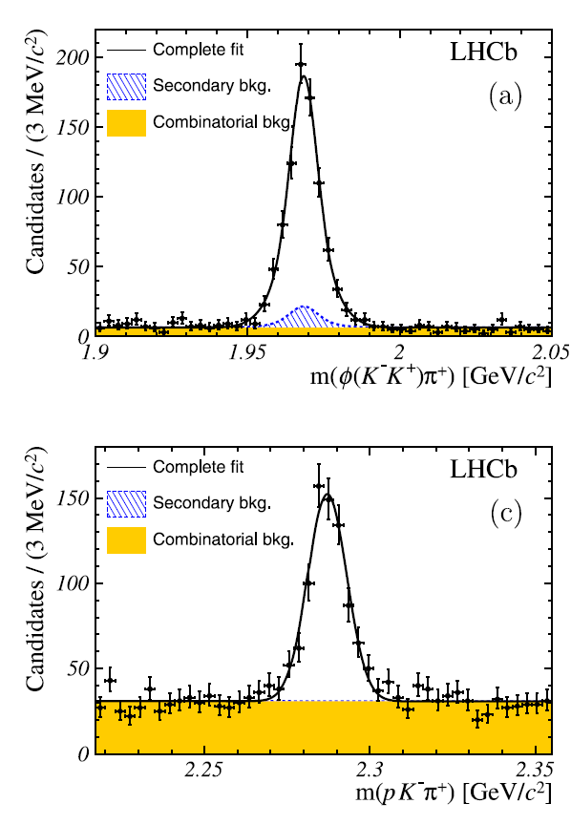
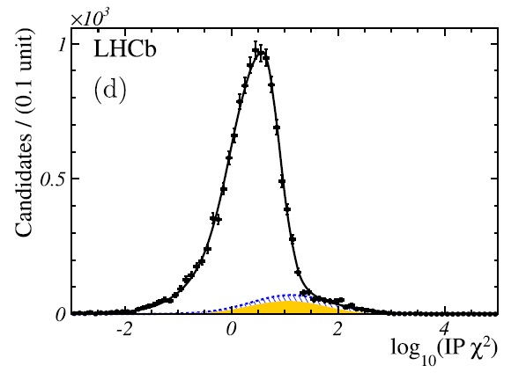
Prompt open charm D_{s},Λ_{c}
NPB 871(2013) 1
All efficiencies were validated using data-driven techniques
Major background has been extracted directly from data
Ds→Κ⁻Κ⁺π⁺_
D⁺→Κ⁻π⁺π⁺
Signal
Combinatorial bkg
b→c bkg
Λc→pΚ⁻π⁺_

Slide 14
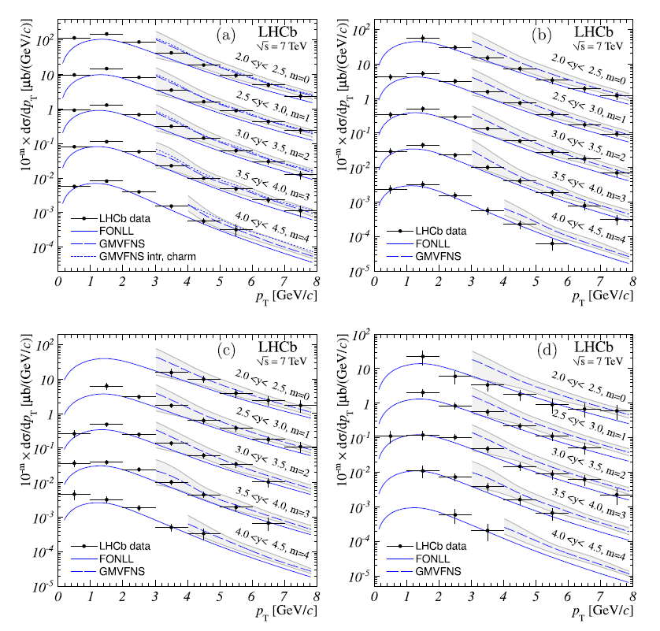
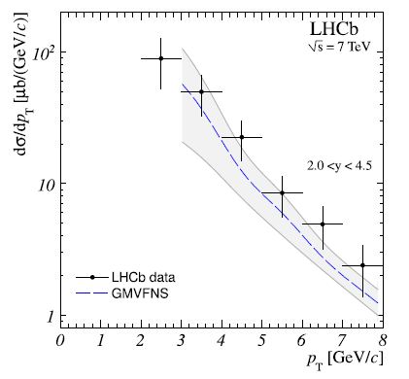
Cross-sections vs theory
D⁰
D⁺
dfgs d
Good agreement with
GMVFNS Kniehl et al.
FONLL Cacciari et al.
D^{*+}
Ds
Λc

Slide 15
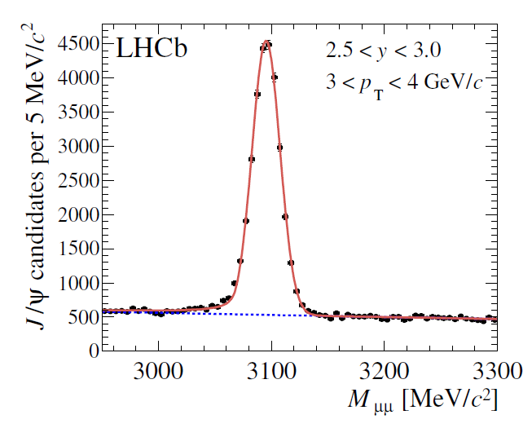
Hidden charm J/ψ
EPJ C71 (2011) 1675
J/ψ→ μ⁺μ⁻ very nice signature, easy to trigger, low background
Measure double differential cross-section
2<y(J/ψ)<4.5
p_{T}(J/ψ)<14 GeV/c
Efficiencies are validated on data

Slide 16
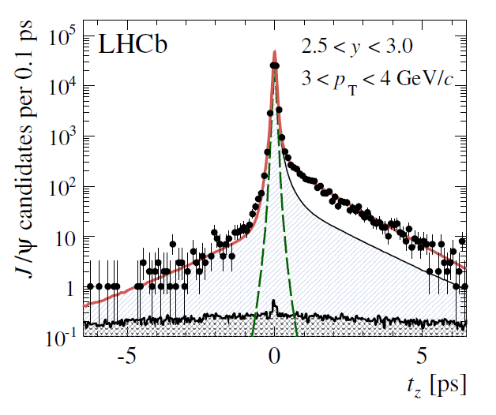
Contribution from B-decays
EPJ C71 (2011) 1675
There is large contribution from decays of long-lived B-hadrons, βγcτ ~ O(1cm)
Use “pseudo-lifetime”
Simultaneous 2D-fit
m(μ⁺μ⁻)
t_{z}

Slide 17
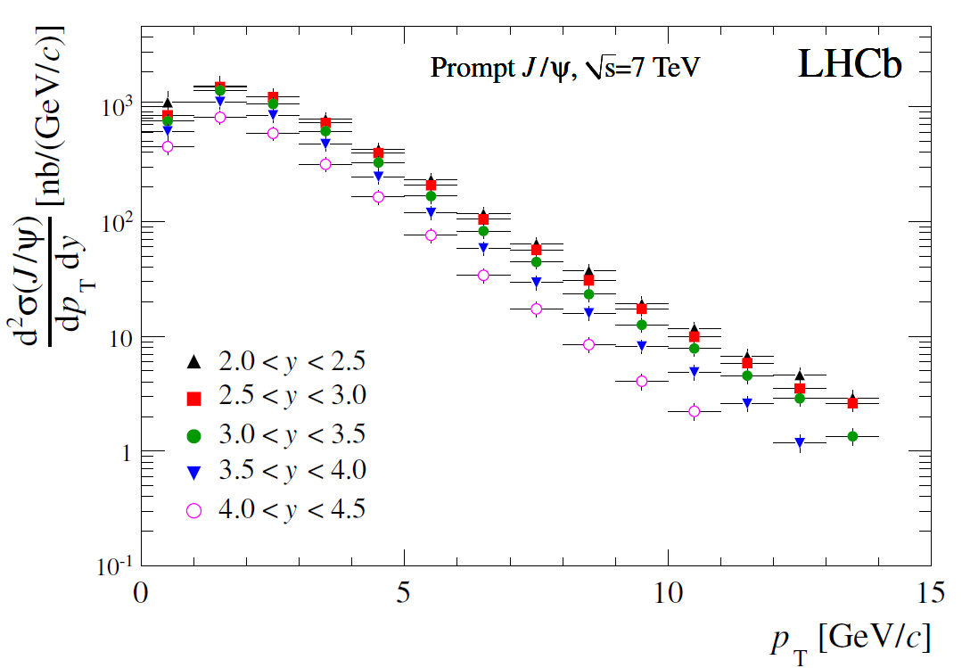
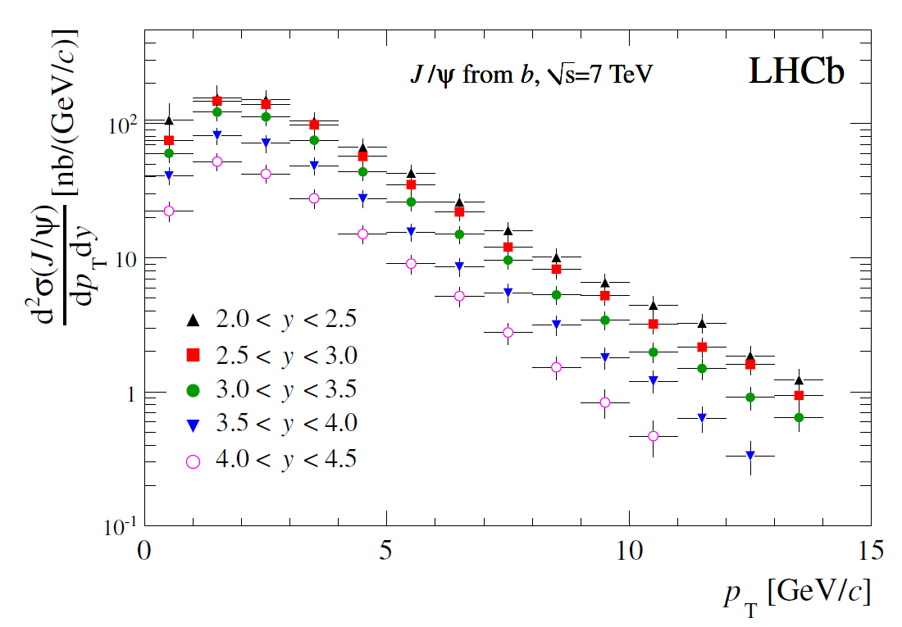
Differential cross-sections
EPJ C71 (2011) 1675
The slopes are different!

Slide 18
Fraction of J/ψ from B-decays
EPJ C71 (2011) 1675
Large raise with pT

Slide 19
Prompt J/ψ DATA vs theory
EPJ C71 (2011) 1675
Artoisenet L0
Butenshoen & Kniehl NLO
Artoisenet et al, Lansberg, NNLO*
Artoisenet, Lansberg, Maltoni;
Campbell, Maltoni, Tramontano NLO CSM
Ma, Wang, Chao NLO CS+CO
Frawley, Ulrich, Vogt NLO CEM

Slide 20
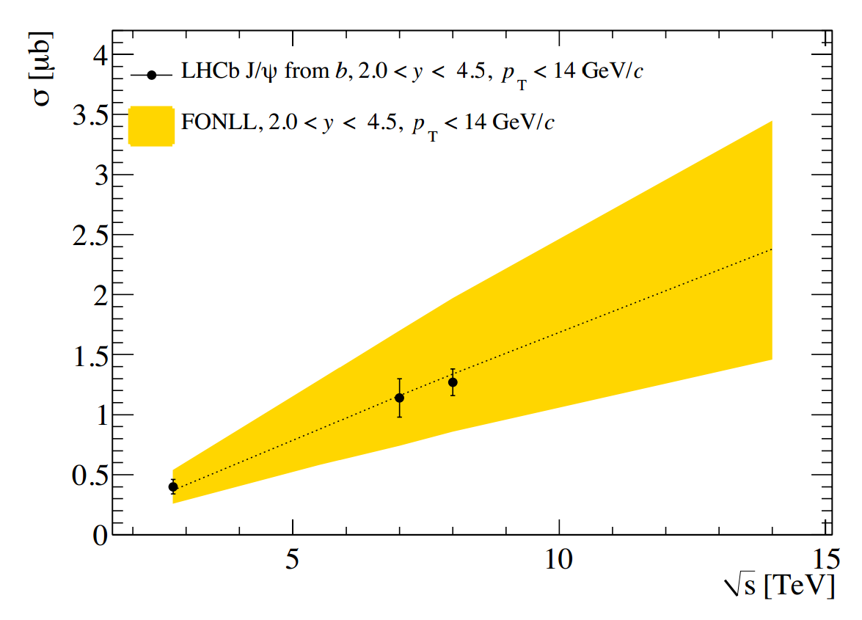
J/ψ at √s=2.76 & 8 TeV
ALICE-PUBLIC-2013-002
LHCb-CONF-2013-013
EPJ C71 (2011) 1675
JHEP 02 (2013) 041
JHEP 06 (2013) 064

Slide 21
Interesting case 2×J/ψ
Valuable information for CS vs CO discrimination

Slide 22
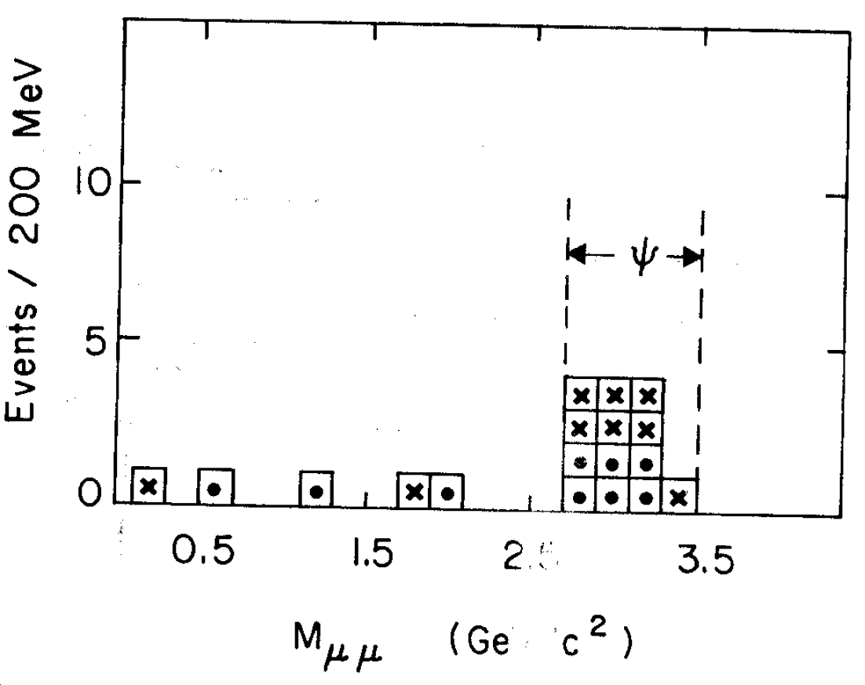
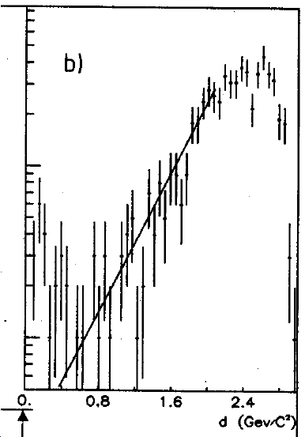
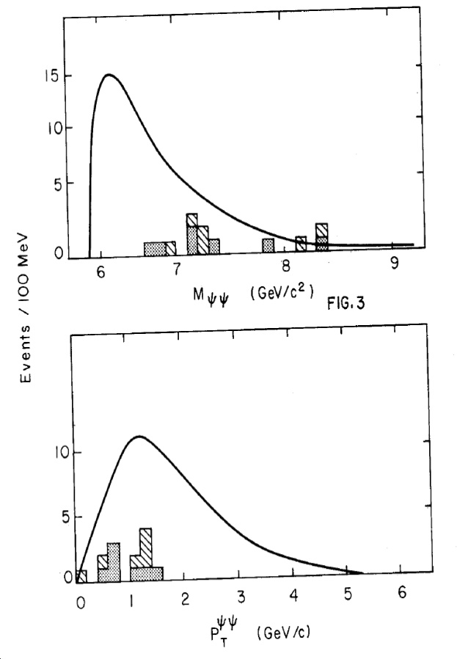
2×J/ψ at (π,p)Pt collisions
σ^{J/ψJ/ψ}/σ^{J/ψ} = (3±1)×10⁻⁴
NA3, 1982
J. Badier et al., “Evidence for ψψ production in π⁻ interactions at 150 and 280 GeV/c", Phys. Lett. B 114, 457 (1982).
J.Badier et al., ”ψψ production and limits on beauty meson production from 400 GeV/c protons”, Phys Lett B 158, 85 (1985)
πPt: 13 ( = 6+7) J/ψJ/ψ
pPt: 16±4 J/ψJ/ψ
(Δm1⊕Δm2)^{½}

Slide 23
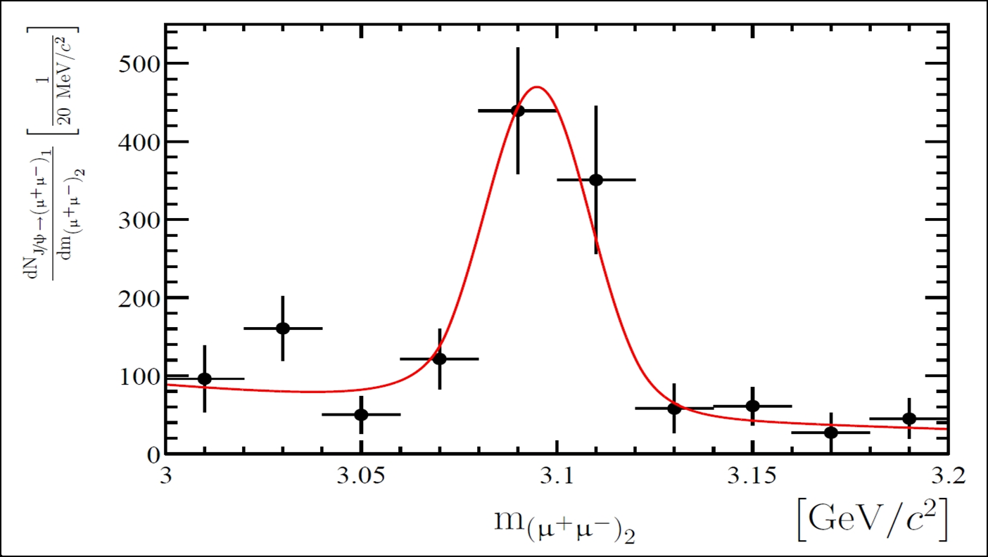
2×J/ψ at LHCb
PLB707 (2012) 52
#J/ψJ/ψ = 136.7 ± 17.5
Theory: CS ~4nb
Qiao, Sun, Sun
Berezhnoy et al.

Slide 24
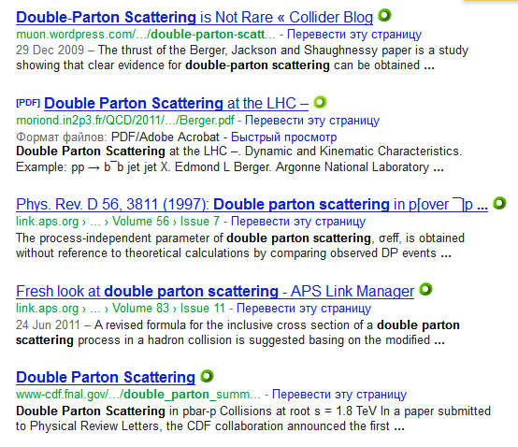
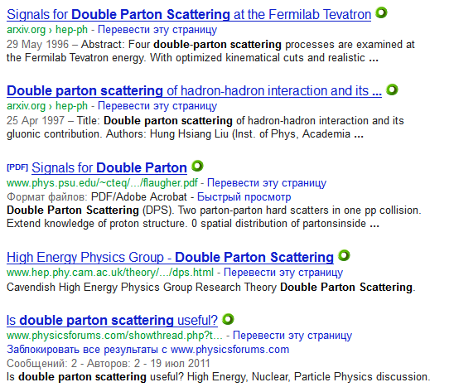
Double Parton Scattering
>300k documents

Slide 25
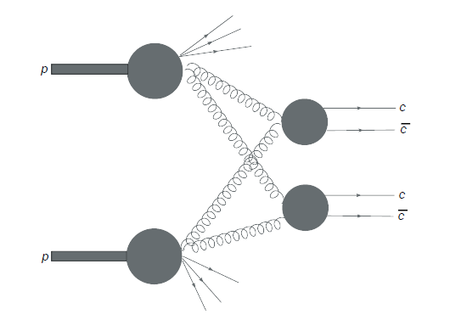
DPS: simple paradigm
scatters
Two independent scattering processes
Relations through (unknown) 2PDFs
Assume factorization of 2PDFs
(Can’t be true for all x,Q²)
Easy to make predictions!
And the predictions are easy to test
Universal (energy and process independent) factor)
CDF, F.Abe et al., PDR 56 3811 (1997)

Slide 26
How to test DPS ?
For two species A and B one need to measure associative production σ(A+B) as well as their inclusive productions σ(A), σ(B)
DPS contribution follows from identity:
Look for the correlations:
p_{T} spectra, Δφ & Δy correlations, mass spectra, polarization effects, …. ?
Inclusive production is well measured at LHCb for many species
J/ψ
Z⁰
Open charm: D⁰, D⁺, D_{s}, Λ_{c}
jets
and many-many others: ψ’, Y(nS), W±, χ_{c}, χ_{b}, B-hadrons, ...
Today 26 pairs:
2×J/ψ (1) J/ψ+open charm (4) 2×open charm (6+10) Z⁰+jets (1)
EJPC 71(2011) 1645
arXiv:1204.1620
CERN-LHCb-PAPER-2012-041
CERN-LHCb-CONF-2011-015

Slide 27
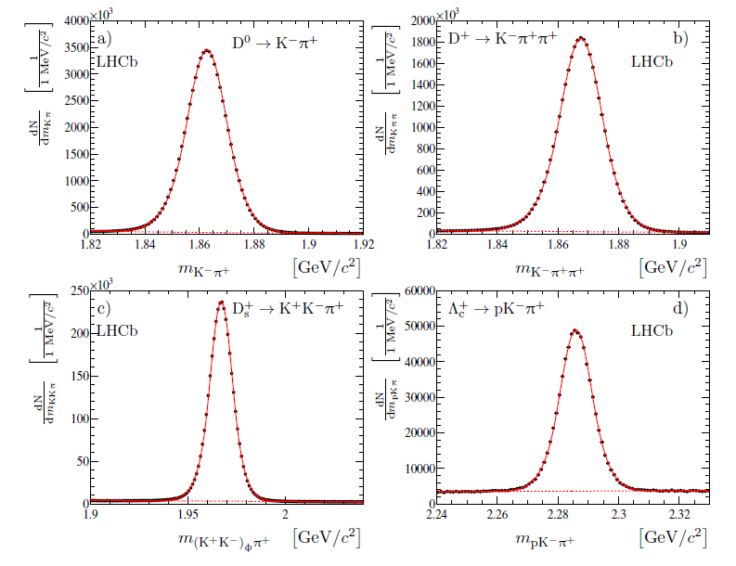
Open charm signals
N(D⁰) ≈ 2×10⁸/fb⁻¹ N(D⁺) ≈1×10⁸/fb⁻¹ N(D_{s}) ≈ 1×10⁷/fb⁻¹ N(Λ_{c}) ≈2×10⁶/fb⁻¹
JHEP 06(2012) 141

Slide 28
Event Selection
J/ψС two charm with common vertex
2×Open charm hadrons
Κ⁻
Κ⁻
μ⁻
π⁺
π⁺
D⁰
D⁰
μ⁺
D⁰

Slide 29
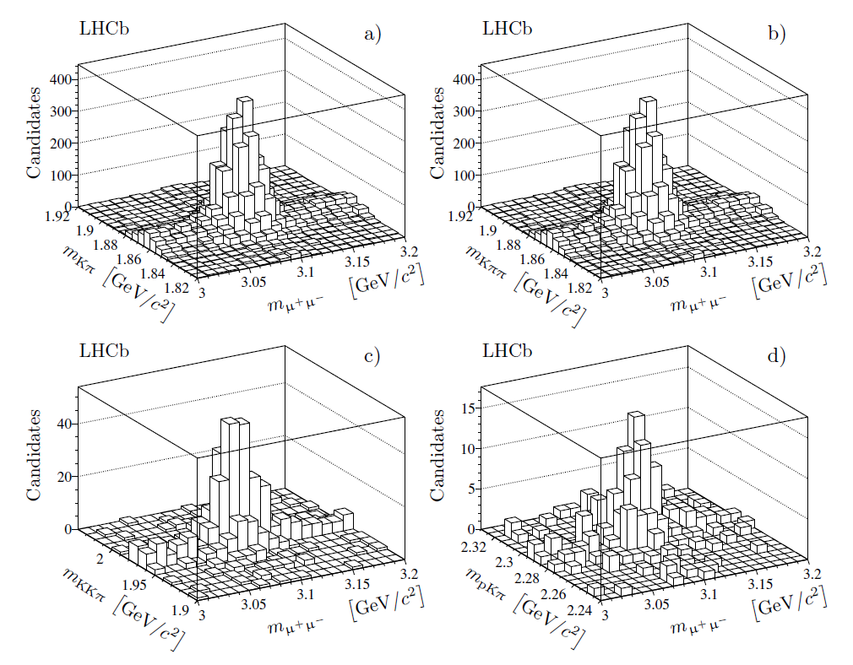
Signal extraction
J/ψ + open charm
clear signals for all
four modes
Significances > 7σ
J/ψD⁰
J/ψD⁺
J/ψDs
J/ψΛc
JHEP 06(2012) 141

Slide 30
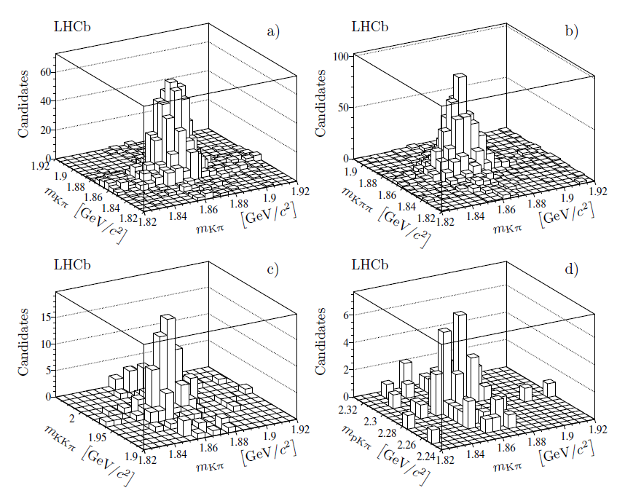
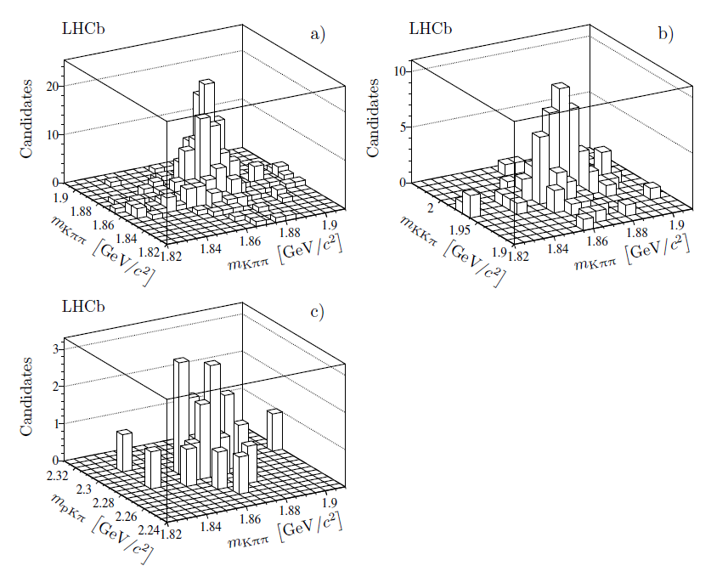
(open charm)²
D⁰ & open charm
D⁺ & open charm
D⁰D⁰
D⁰D⁺
D⁺D⁺
D⁺Ds
D⁰Ds
D⁰Λc
D⁺Λc
For all cases significance > 5s,
2.5 sigma D⁺Λc⁺
JHEP 06(2012) 141
JHEP 06(2012) 141

Slide 31
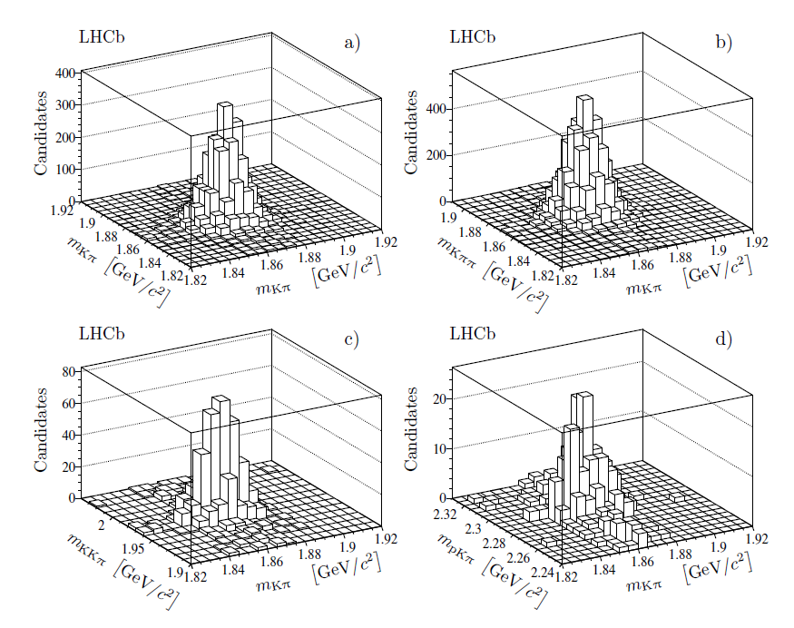
Open charm + open anti-charm
D⁰ & open anti-charm
D⁺ & open anti-charm
$$D^{0}{\overline{D}}^{0}$$
D⁰D⁻
D⁺D⁻
$${\text{D}}^{+}{\text{D}}_{s}^{−}$$
$${\text{D}}^{0}{\text{D}}_{s}^{−}$$
$${\text{D}}^{0}{\overline{Λ}}_{c}^{−}$$
${\text{D}}^{+}{\overline{Λ}}_{c}^{−}$
For all cases significance > 8σ
JHEP 06(2012) 141
JHEP 06(2012) 141

Slide 32
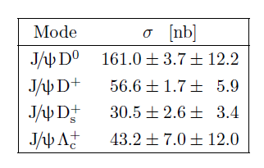
Cross-sections
Use per-event efficiency, mainly from DATA: trigger, particle ID, background etc.
Major systematic:
tracking (reducible)
Br(Λ_{c}), Br(D_{s}), ….
JHEP 06(2012) 141

Slide 33
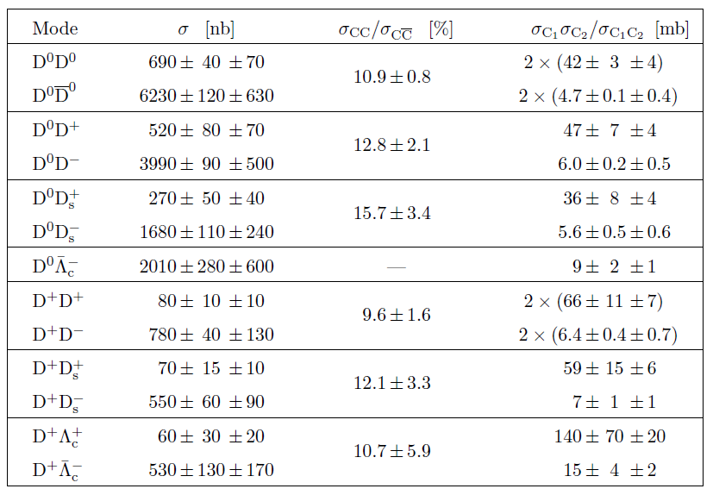
Cross-sections
Major systematic: tracking (reducible) and Br(Λ_{c}), Br(D_{s}), ….
JHEP 06(2012) 141

Slide 34
Cross-sections
A.Berezhnoy et al., Phys Rev D57 4385 (1998)
S.P.Baranov. Phys Rev D73 074021 (2000)
J.-P.Lansberg. Eur.Phys.J. C61 693 (2009)
JHEP 06(2012) 141 JHEP 03(2014) 108

Slide 35
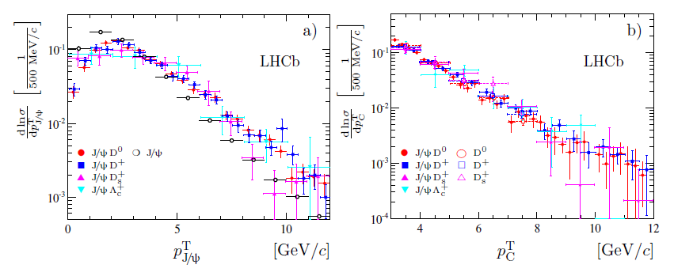
Event Properties: p_{T}
J/ψ + open charm:

Slide 36
Slope parameter for p_{T}-spectra
Fit p_{T}-spectra with exponential function:
~ exp (β×p_{T})
DPS: expected similarity between inclusive and$\text{c}\overline{\text{c}}\text{c}\overline{\text{c}}$
Expected to be similar between J/ψC and CC
No reason to be the same for J/ψC and inclusive
Expected to be similar between $\text{c}\overline{\text{c}}$and inclusive

Slide 37
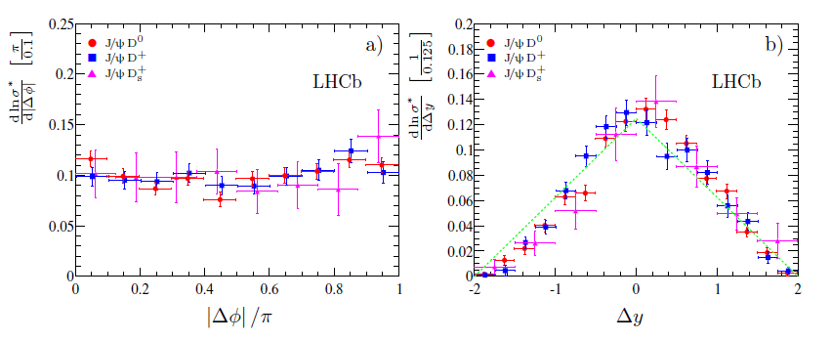
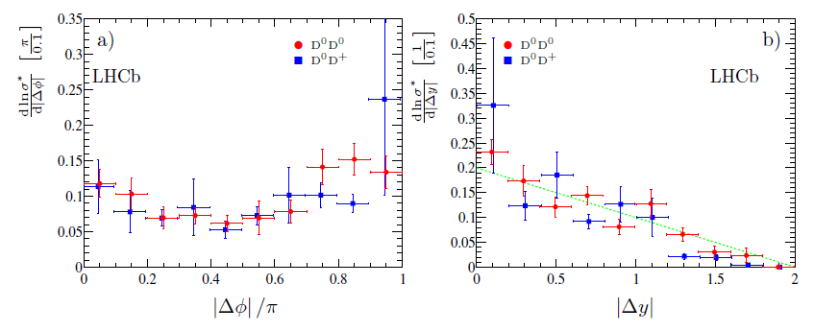
Δφ & Δy correlations
No evident correlations

Slide 38
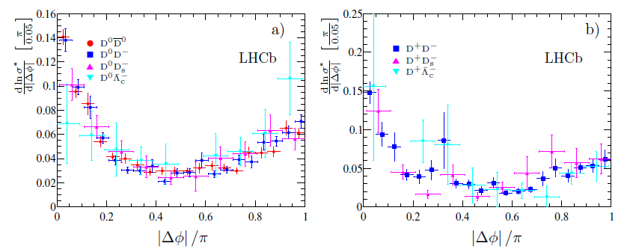
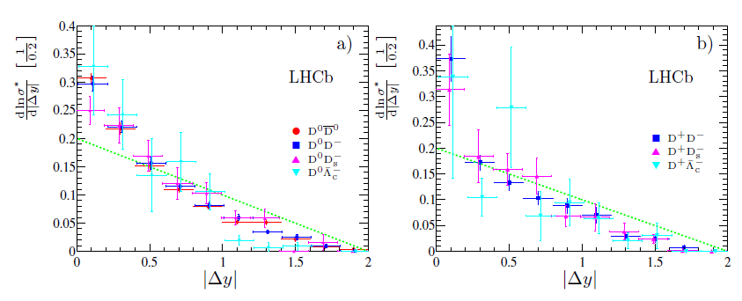
Δφ & Δy correlations
Clear correlations!

Slide 39
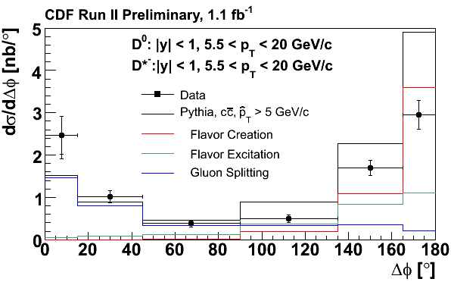
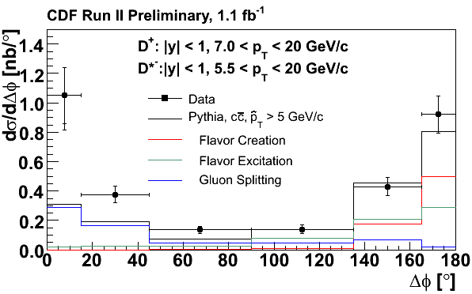
Compare with CDF’2k+6
http://www-cdf.fnal.gov/physics/new/bottom/060921.blessed-double-charm-corr/
CDF: azimuthal correlations for D^{(0,+)} D^{*-}
Large gluon splitting contribution
Very different kinematical region

Slide 40
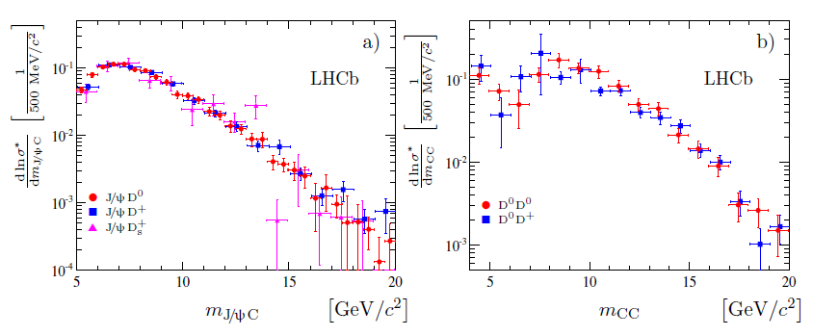
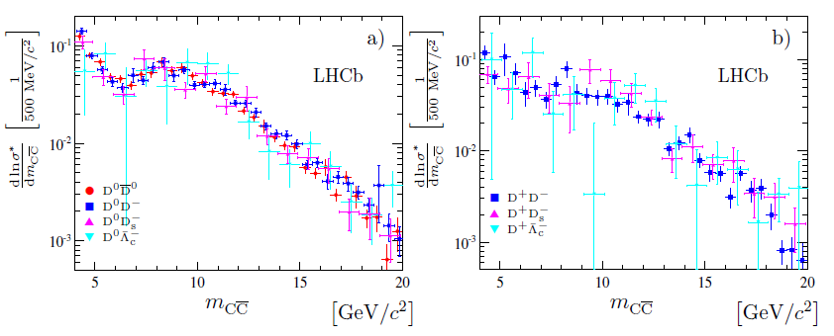
Mass distributions
The same shape for m>7 GeV/c²

Slide 41
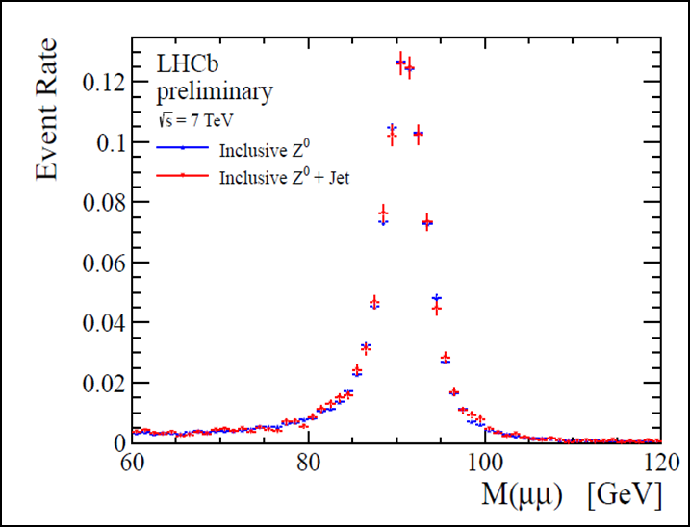
Z⁰ + charm meson
We have clear D-signals, we have clear Z⁰→μ⁺μ⁻ signals: try to merge them together
CERN-LHCb-CONF-2012-016
+

Slide 42
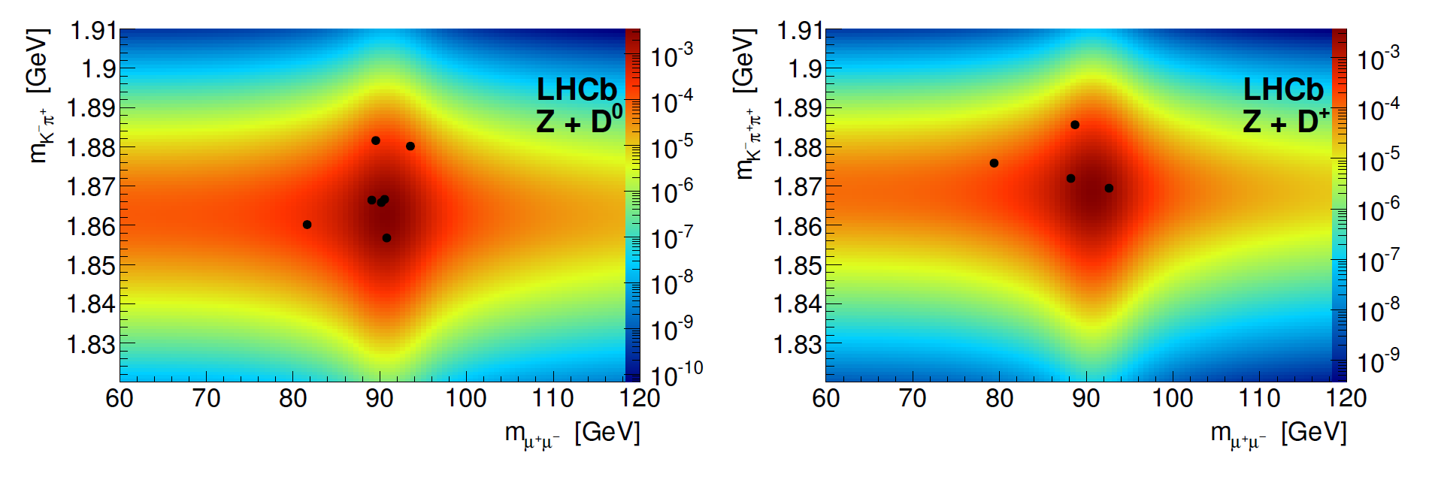
Z⁰ + charm mesons
11 signal events: 7 Z⁰&D⁰ and 4 Z⁰&D⁺
Statistical significance >5σ

Slide 43
Z⁰ + charm meson
Cross-section: sum of SPS and DPS
For Z⁰+D⁰ case: in agreement, for Z⁰+D⁺ case too small
More data needed to make conclusions
Only ~1/3 of data is used in this analysis

Slide 44
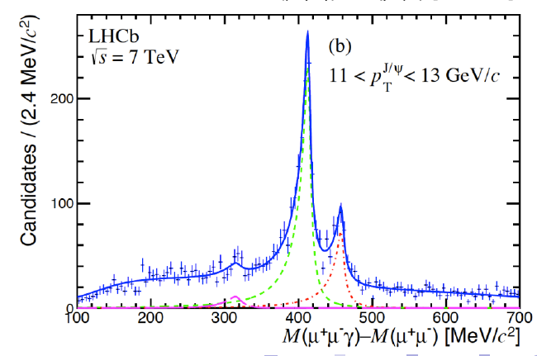
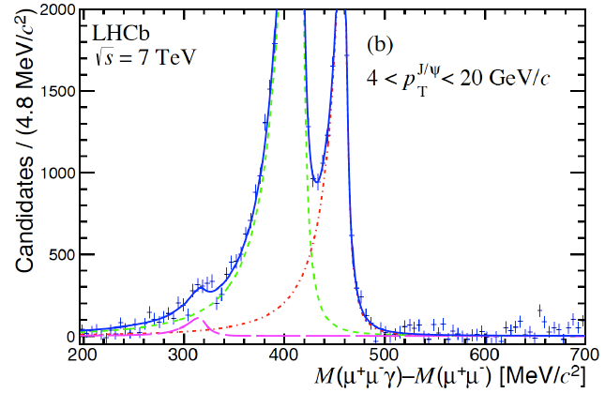
P-wave charmonia: χ_{c} states
JHEP 10 (2013) 115
χ_{c}→(J/y →μ⁺μ⁻)γ with γ-conversions
Excellent mass resolution: resolve χ_{c1} and χ_{c2} !
First evidence of χ_{c0} at hadron machines!

Slide 45
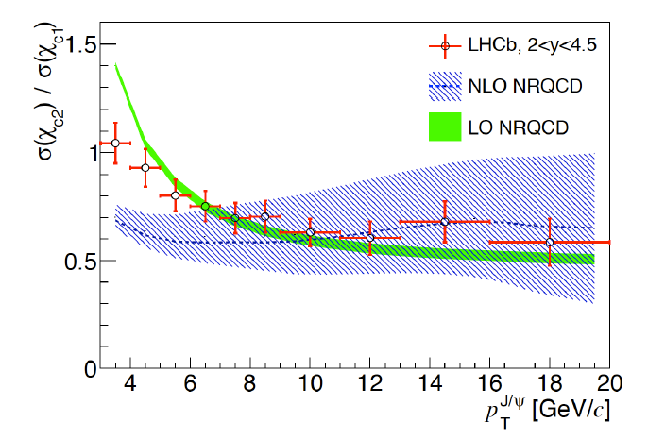
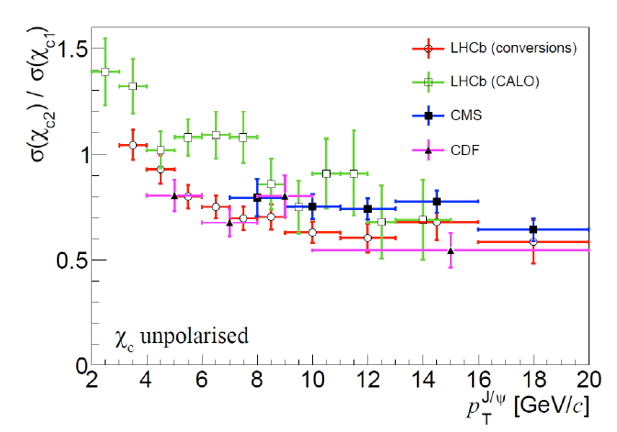
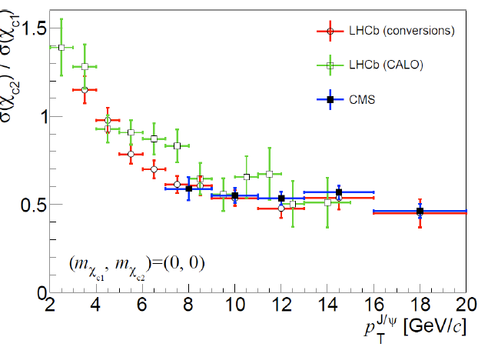
χ_{c2}/χ_{c1} ratio
JHEP 10 (2013) 115
for on-shell gluons σ(gg→χ_{c1}) =0
Important ingredient for S &P-wave CO

Slide 46
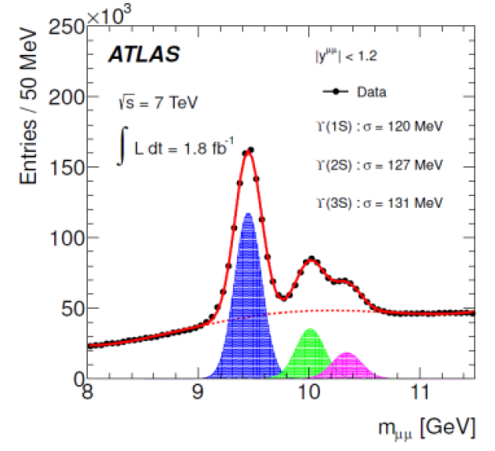
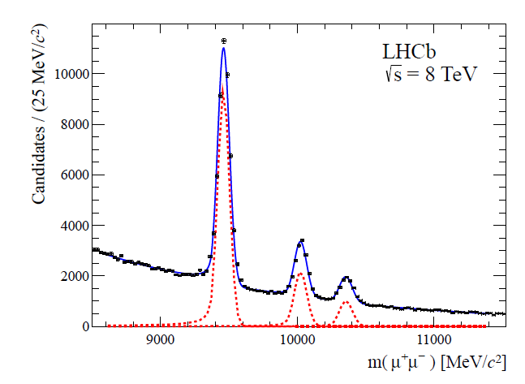
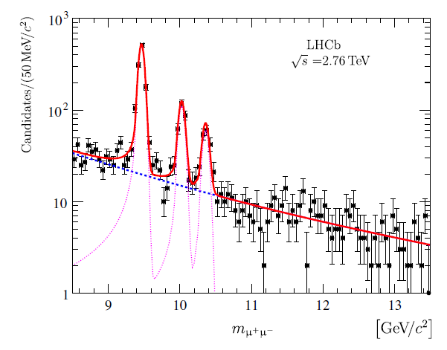
ϒ production @2.76,7&8TeV
ϒ →μ⁺μ⁻ excellent mass resolution!
EPJ C72 (2012) 2025
JHEP 06 (2013) 064
EPJ C74 (2014) 2835

Slide 47
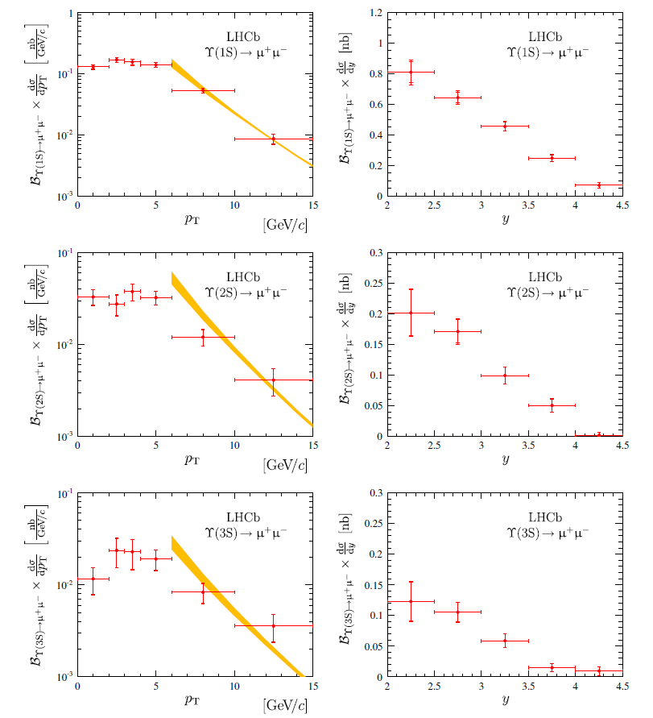
ϒ production
JHEP 06 (2013) 064
EPJ C74 (2014) 2835

Slide 48
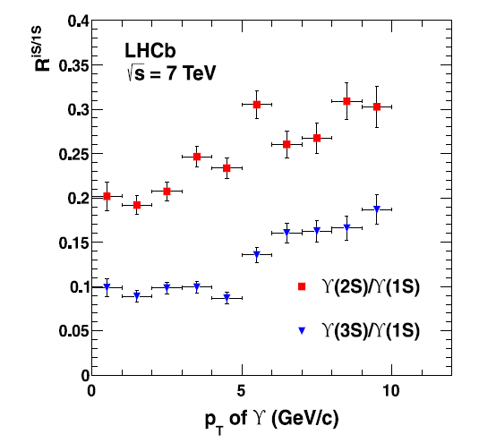
ϒ(nS)/ϒ(1S) ratios
EPJ C72 (2012) 2025
JHEP 06 (2013) 064
EPJ C74 (2014) 2835

Slide 49
Other interesting topics
Production in pA & Ap collisions
B-hadron production
B_{c} production
Search for double charmed baryons
Leading role of Tsinghua group
JHEP 02 (2014) 074
LHCb-PAPER-2014-015, arXiv:1405.5151
JHEP 08 (2013) 117
PRL 109 (2012) 231001
JHEP 12 (2013) 090

Slide 50
Polarisation fiasco (again)
EPJ C73 (2013) 2631
ψ’ was expected to be easier:
Free from feeddown
LHCb-PAPER-2013-067, arXiv:1403.1339

Slide 51
Summary
HQ production is interesting & hot topic
Many active players, including LHCb
There is great theory progress
.. and nice collaboration
Some “old” puzzles are still with us
Polarization, role of CO
Interesting data appears from LHC that need to be explained: challenge for theory
At high collision energies/large gluon densities new effects appears, e.g. DPS

