Slide 1
Heavy Flavour in a Nutshell
(for a 27-km annular nut at 1.8K)
Robert W. Lambert, CERN

Slide 2
Flavour physics timeline
EXPERIMENT
Gell-Mann: Strange
AGS : CPV in Kaons
Rutherford: Proton
Chadwick: Neutron
SLAC: Up+Down
Argus: B-mixing
E288: Bottom
D∅ + CDF: Top
SLAC: Charm
Prout: Proton
Cabbibo: angle
GIM: charm
Rutherford: Neutron
Anderson: EWSB
Brout-Englert-Higgs-
CKM: 3rd Generation
Gell-Mann: 8-fold way
Guralnik-Hagen-Kibble
THEORY

Slide 3
Outline
Welcome to our universe
Introduction to flavour physics
Hottest new physics searches
Flavour-specific asymmetry
Recent papers:
D∅ measurement of A^{b}, 3.2σ deviation from the SM (May 2010) Evidence for an anomalous like-sign dimuon charge asymmetry PRL. 105, 081801 (2010)
Nierste and Lenz B-mixing update (Feb 2011) Numerical updates of lifetimes and mixing parameters of B mesons hep-ph arxiv:1102.4274
WMAP 7-year sky maps (Feb 2011) Seven-Year Wilkinson Microwave Anisotropy Probe (WMAP) Observations: Sky Maps, Systematic Errors, and Basic Results Jarosik, N., et.al., 2011, ApJS, 192, 14

Slide 4
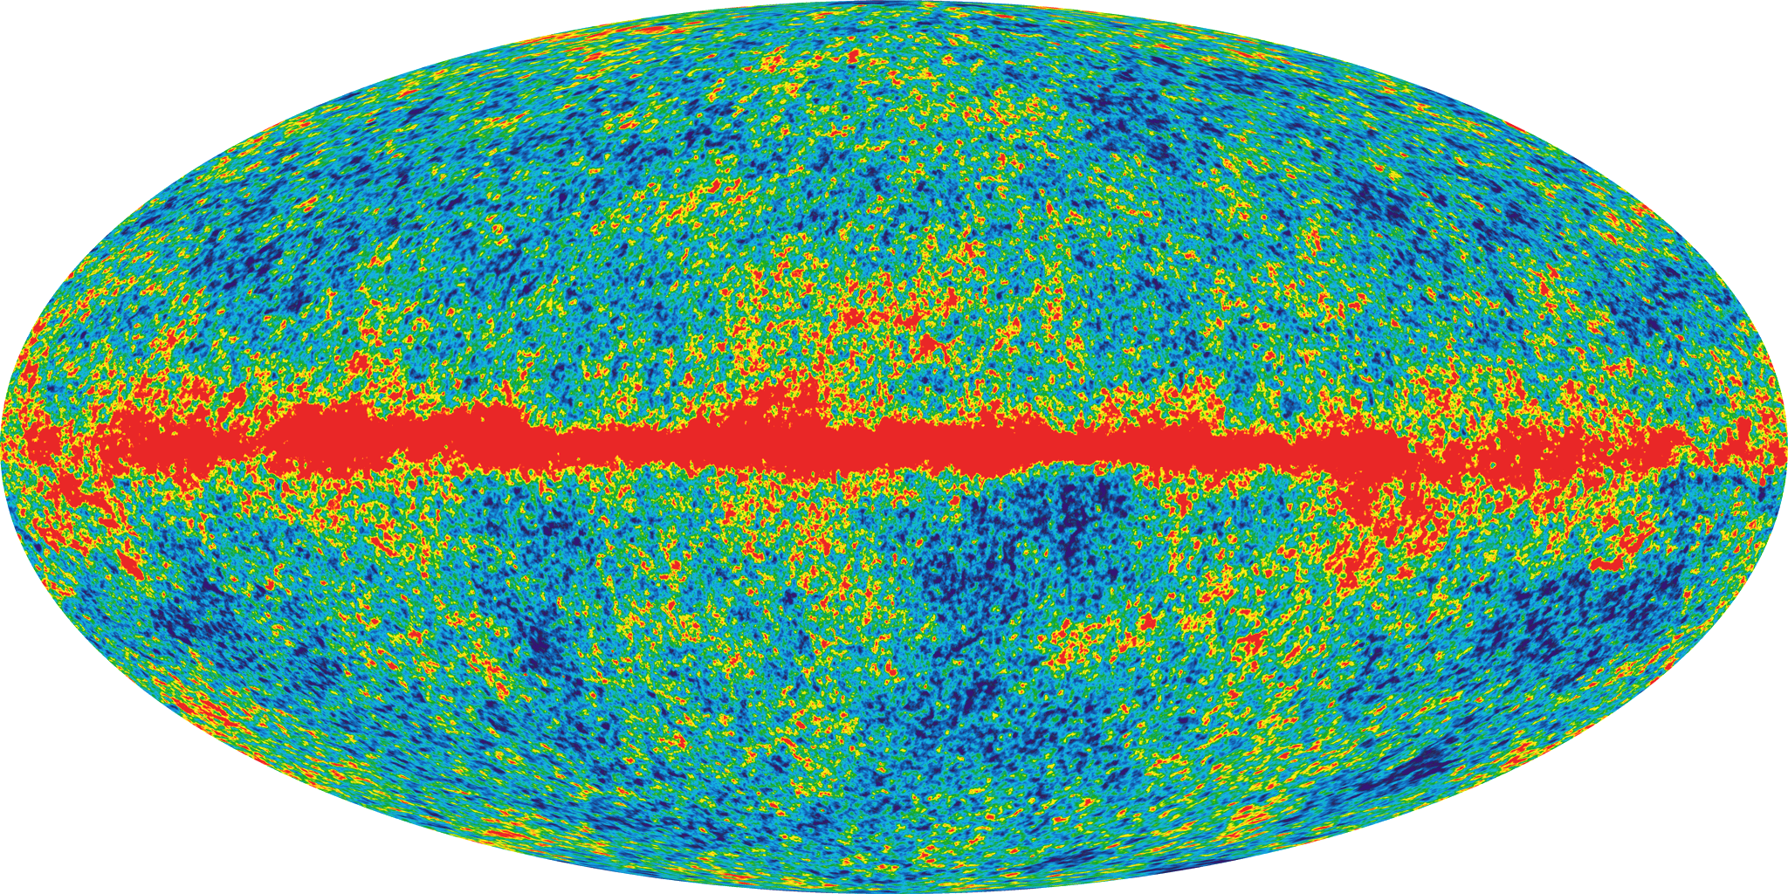
Light
(13.75 ± 0.13) Gyr
Notes:
WMAP 7: http://lambda.gsfc.nasa.gov/product/map/dr4/pub_papers/sevenyear/basic_results/wmap_7yr_basic_results_reprint.pdf
Seven-Year Wilkinson Microwave Anisotropy Probe (WMAP) Observations: Sky Maps, Systematic Errors, and Basic Results Jarosik, N., et.al., 2011, ApJS, 192, 14

Slide 5
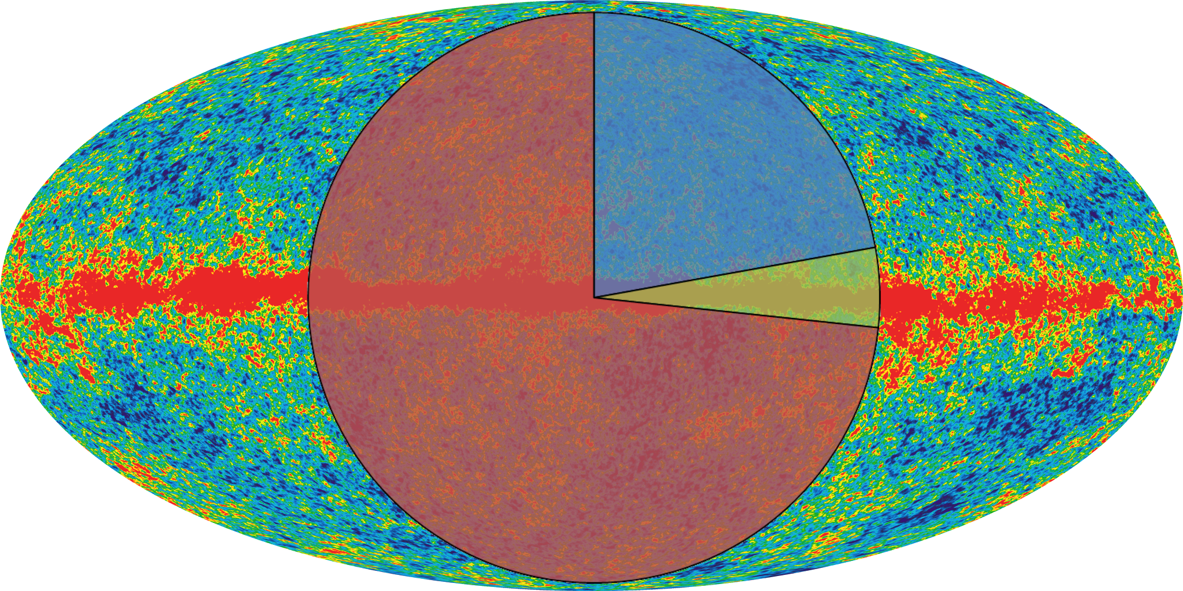
Matter
22% Cold Dark Matter
5% Atoms
73% Dark Energy
Notes:
WMAP 7: http://lambda.gsfc.nasa.gov/product/map/dr4/pub_papers/sevenyear/basic_results/wmap_7yr_basic_results_reprint.pdf
Seven-Year Wilkinson Microwave Anisotropy Probe (WMAP) Observations: Sky Maps, Systematic Errors, and Basic Results Jarosik, N., et.al., 2011, ApJS, 192, 14

Slide 6
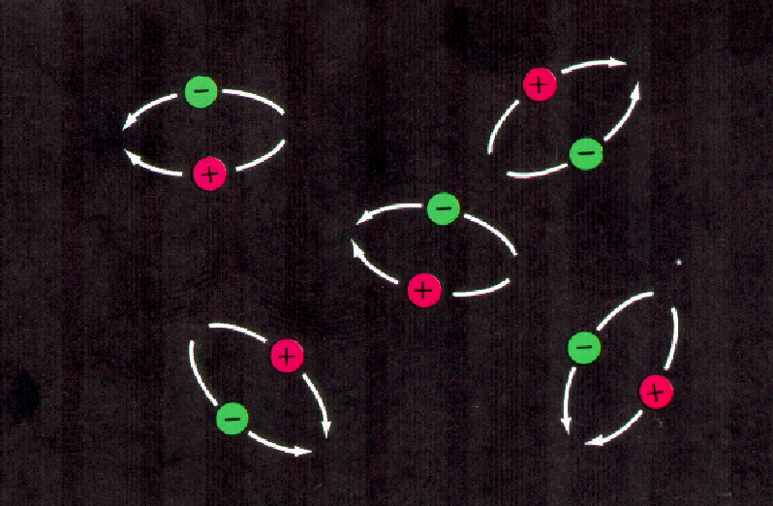
Antimatter
Matter + Antimatter = photons

Slide 7
Antimatter
Matter + Antimatter = photons
± CP-violation, CPV
observable difference between matter and antimatter

Slide 8
Antimatter
Matter + Antimatter = photons
± CP-violation, CPV
observable difference between matter and antimatter
REALITY
SM (maximal CPV)
You Are Here
Where did you go? Guys…? Guys…??

Slide 9
What does that have to do with heavy flavour physics?

Slide 10
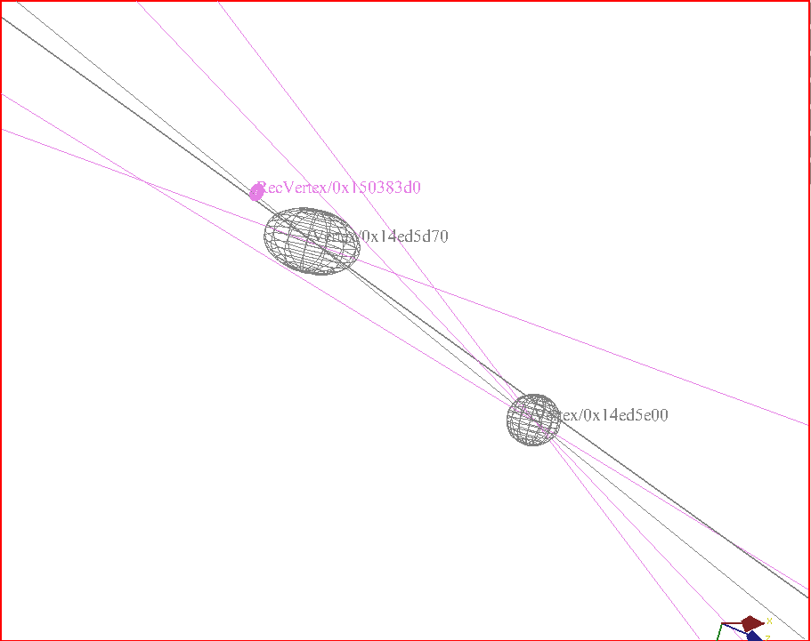
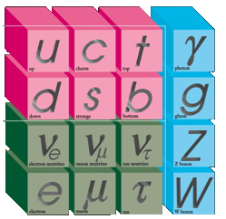
A beautiful image
Heavy flavour is a microcosm of the entire standard model
PV
B_{s}
SV
μ⁻
D_{s}⁺
TV
LHCb Preliminary
π⁺,Κ⁺,Κ⁻
EVT: 49700980
RUN: 70684

Slide 11
Complementarity
There are in general two types of new physics searches
Direct Searches
Precision measurements
LSP
Rare Decays
Rare Decays
Higgs
CP-violating asymmetries
CP-violating asymmetries
4th Gen
“Old physics” previous collider searches
Hidden valley
Mixing parameters
Mixing parameters
WIMP
/
SMP
CKM measurements
0.1
1
New Physics Scale / Collider Energy
1000

Slide 12
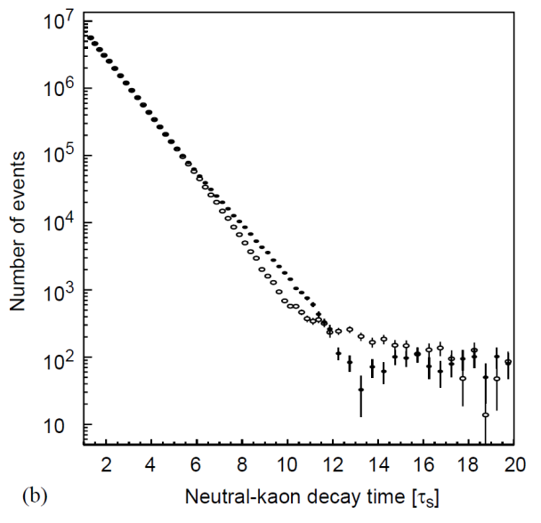
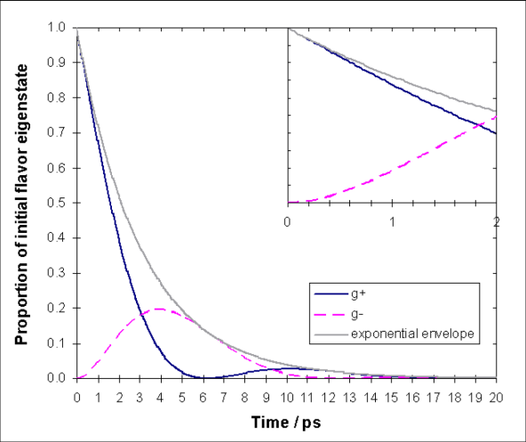
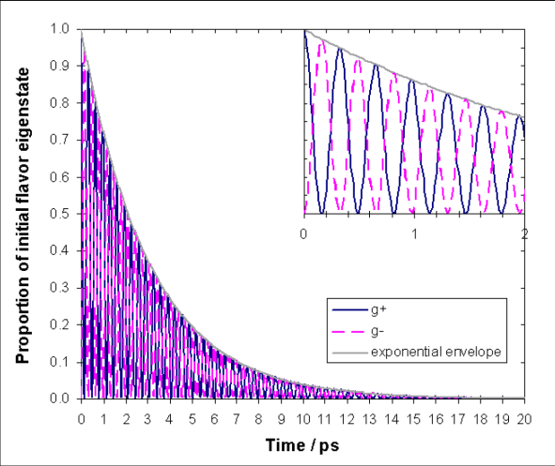
Neutral mesons are
“mass-decay eigenstates are not the flavour eigenstates”
Probably the weirdest phenomenon in physics!
“neither of those are the CP-eigenstates”
CP-violation is very weird in itself
Observation of CPV in Kaons in 1964, before any predictions!
(CPLear)
(PDG)
(PDG)

Slide 13
Questions
Where is the CP-violation we need?
What is the flavour structure of new-physics?
But first we ask ourselves:
How can we best look for this new physics, and where?

Slide 14
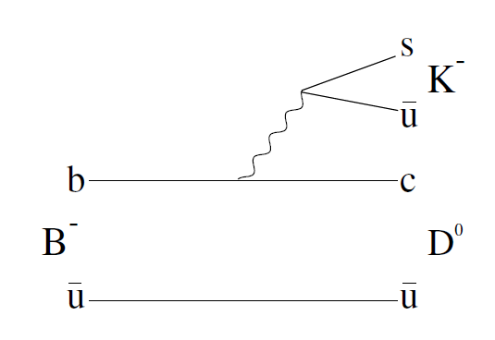
Looking for NP
Find a place where new physics is unlikely
Precisely measure well-predicted observables
Find a place where new physics could enter
Precisely measure related observables
Unlikely: tree-level decays
Likely: loops and penguins
q
q
?
q
q

Slide 15
Looking for NP
Find a place where new physics is unlikely
Precisely measure well-predicted observables
Find a place where new physics could enter
Precisely measure related observables
Unlikely: tree-level decays
Likely: loops and penguins
q
?
q
?
q
q

Slide 16
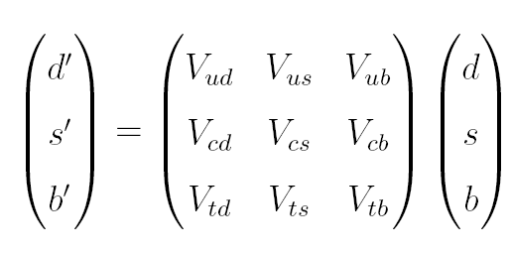
Looking for CPV
SM has only one source of CPV, from the CKM, a phase
Observe this and any NP phase with interference:
Need observables with two competing amplitudes
SM phase manifests most obviously in the b-quark system
Measure in many different ways to constrain the same phase

Slide 17
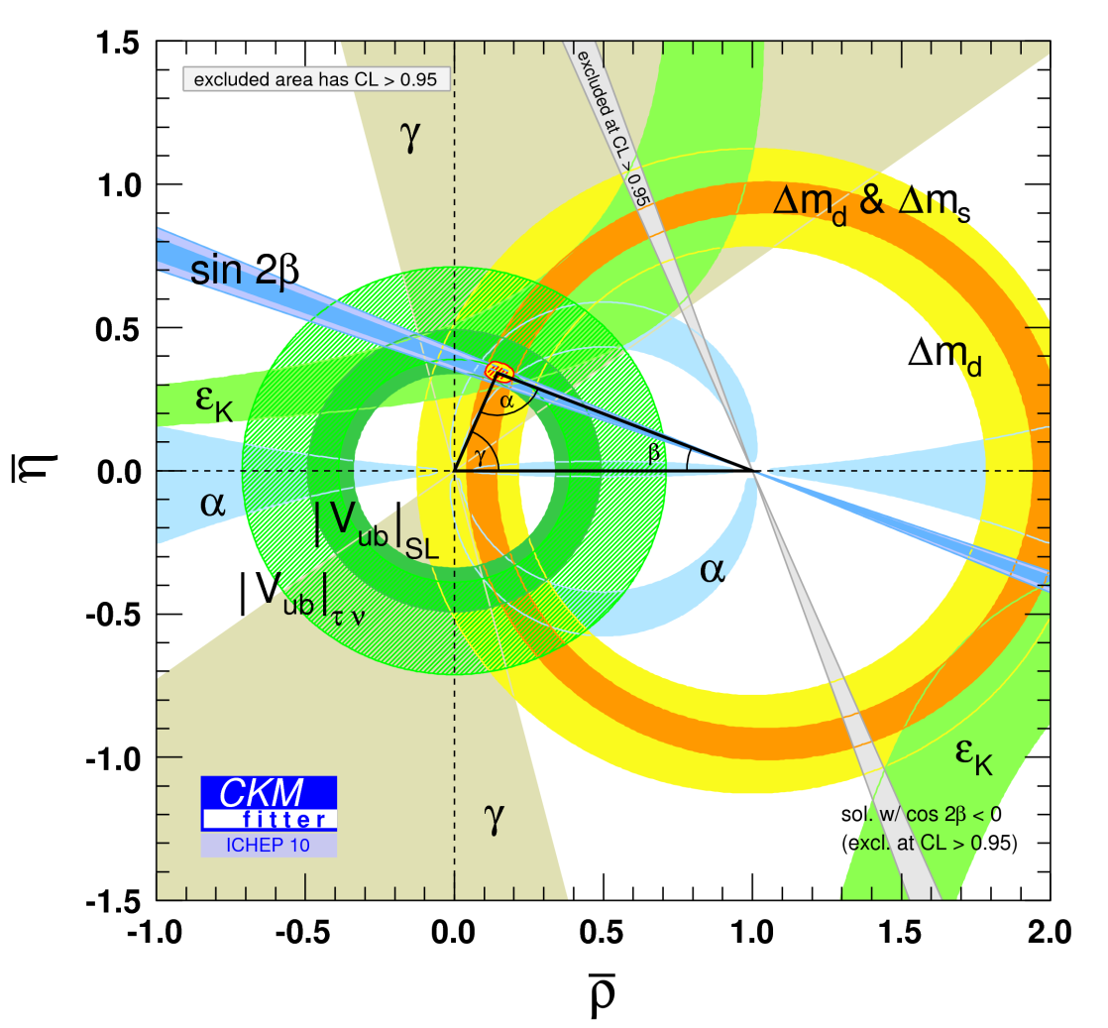
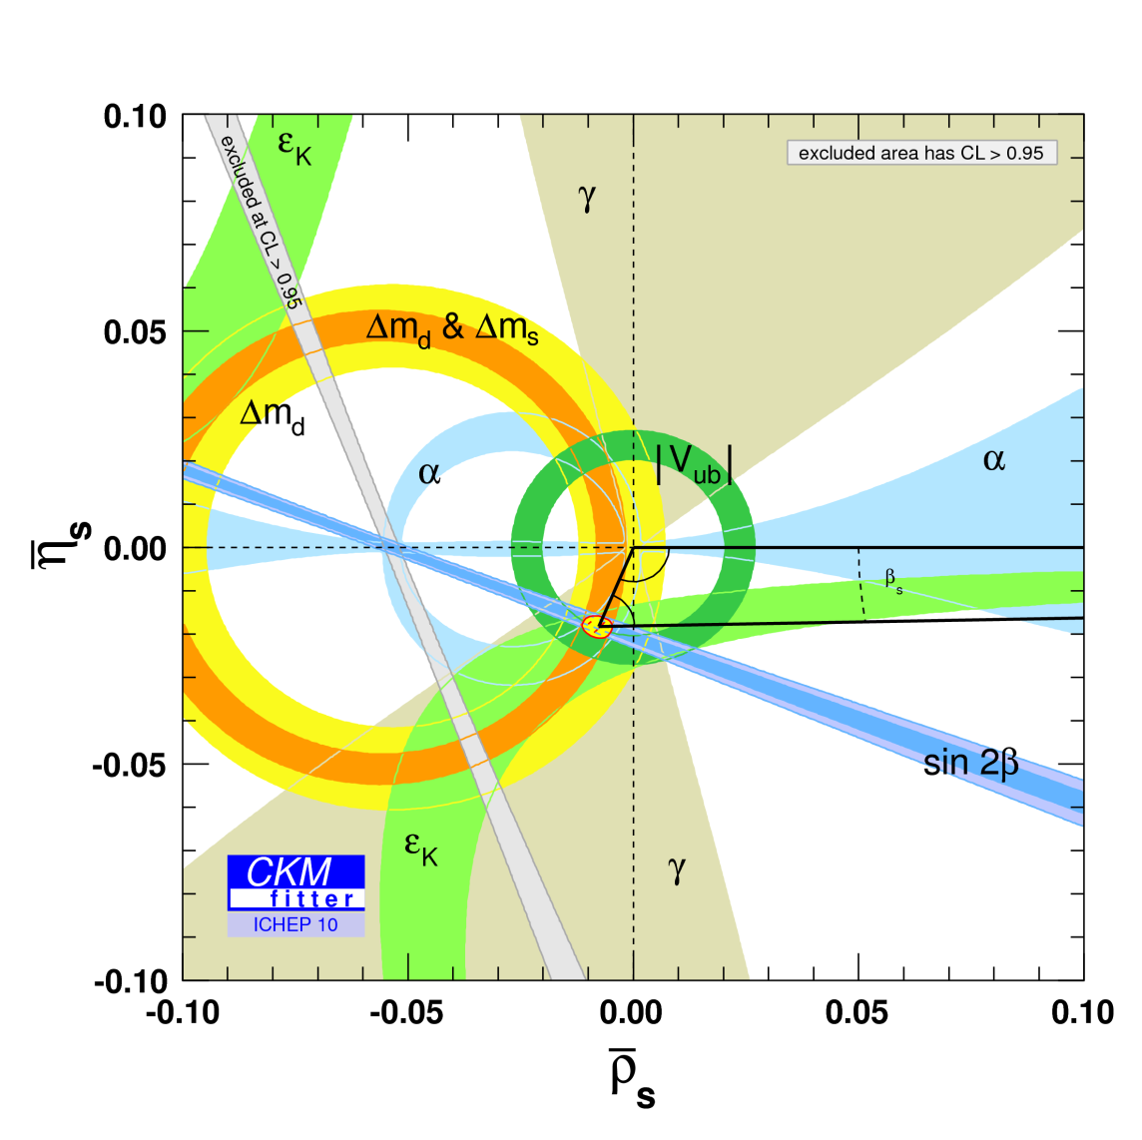
CKM - status
Plot everything together on a single graph
Everything is consistent ... so far ...

Slide 18
Hottest new physics searches

Slide 19
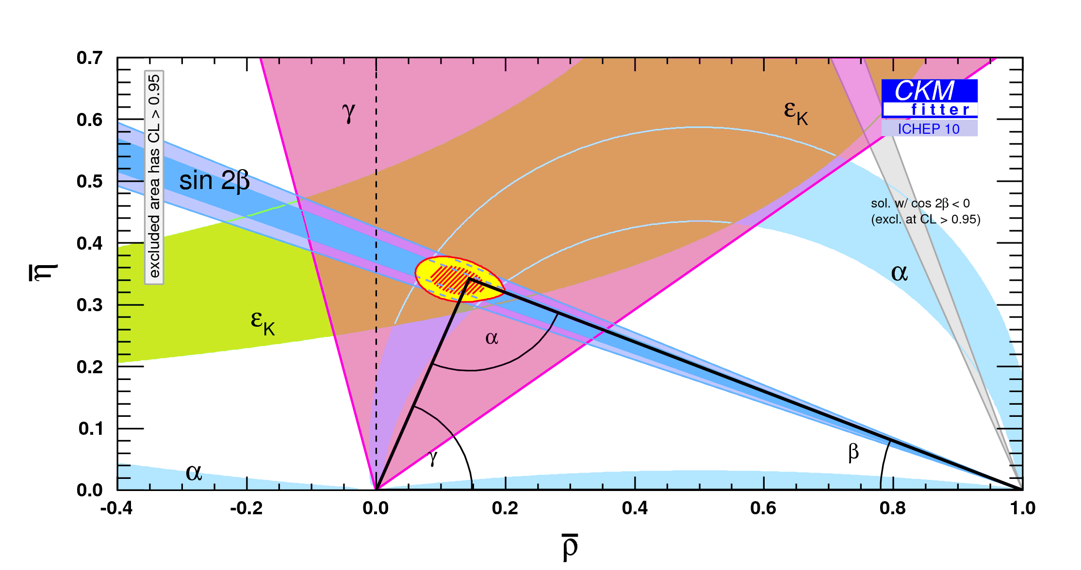
Looking for CP (1)
Check CP-violating observables
Disagreement would point to CPV new physics
No hints yet, but the angle γ is not well known

Slide 20
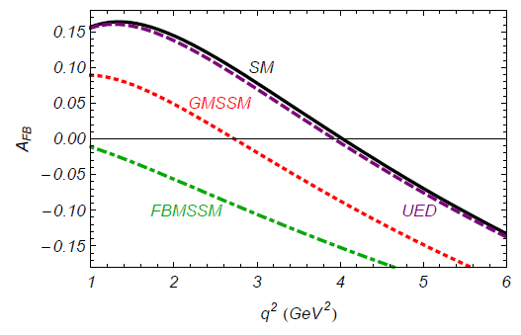
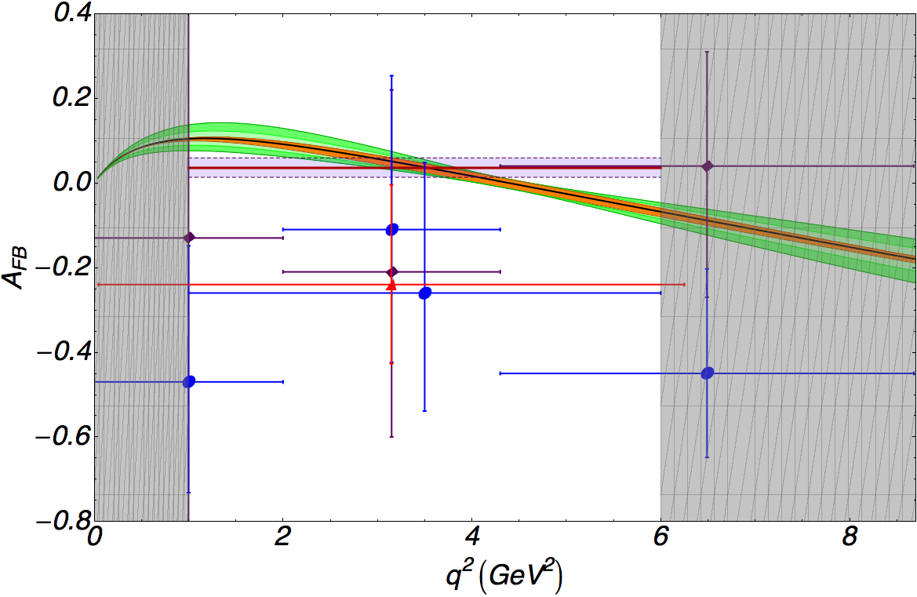
Looking for flavour (1)
B_{d}→ K*μμ has both loops and penguins!
Amongst many observables A_{fb} is sensitive to SUSY
e.g.
CDF
SM
BELLE
BABAR

Slide 21
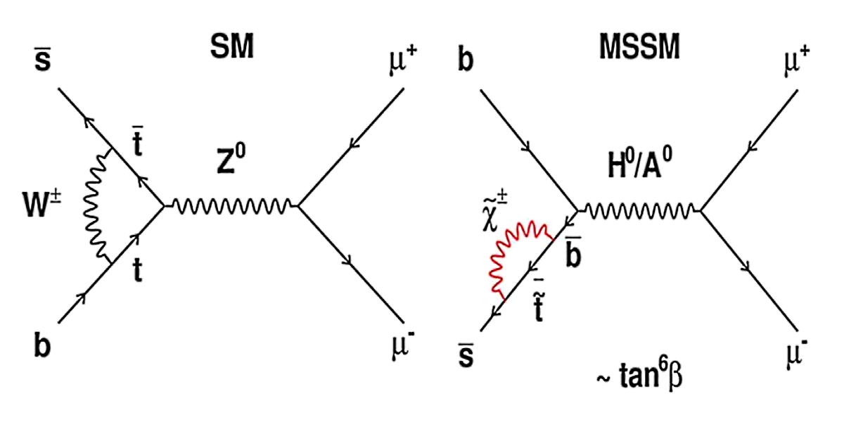
Looking for flavour (2)
Very rare decays, where SM BR predictions are very good
In the case of B_{s/d}→μμ, the rate is very sensitive to SUSY
e.g.
CDF Prelim:
LHCb:

Slide 22
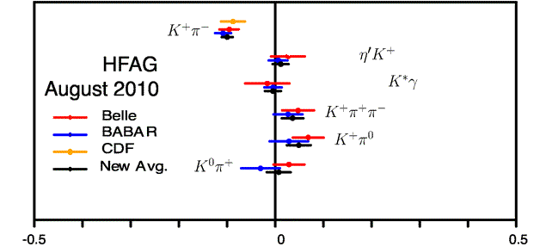
Looking for CP (2)
CP-asymmetry in decays (Direct CP-violation)
Interesting hint: the B→Kπ “puzzle”
Precision two-body B-decays will be very interesting
A_{CP}
HFAG August 2010
CP asymmetry

Slide 23
Looking for both
Mixing can be modified in both magnitude and phase
Define a complex number parameter Δ_{q} for the new physics
Just like we did with the CKM
Collect all the measurements together
Plot all at once in 2D (complex plane)
?

Slide 24
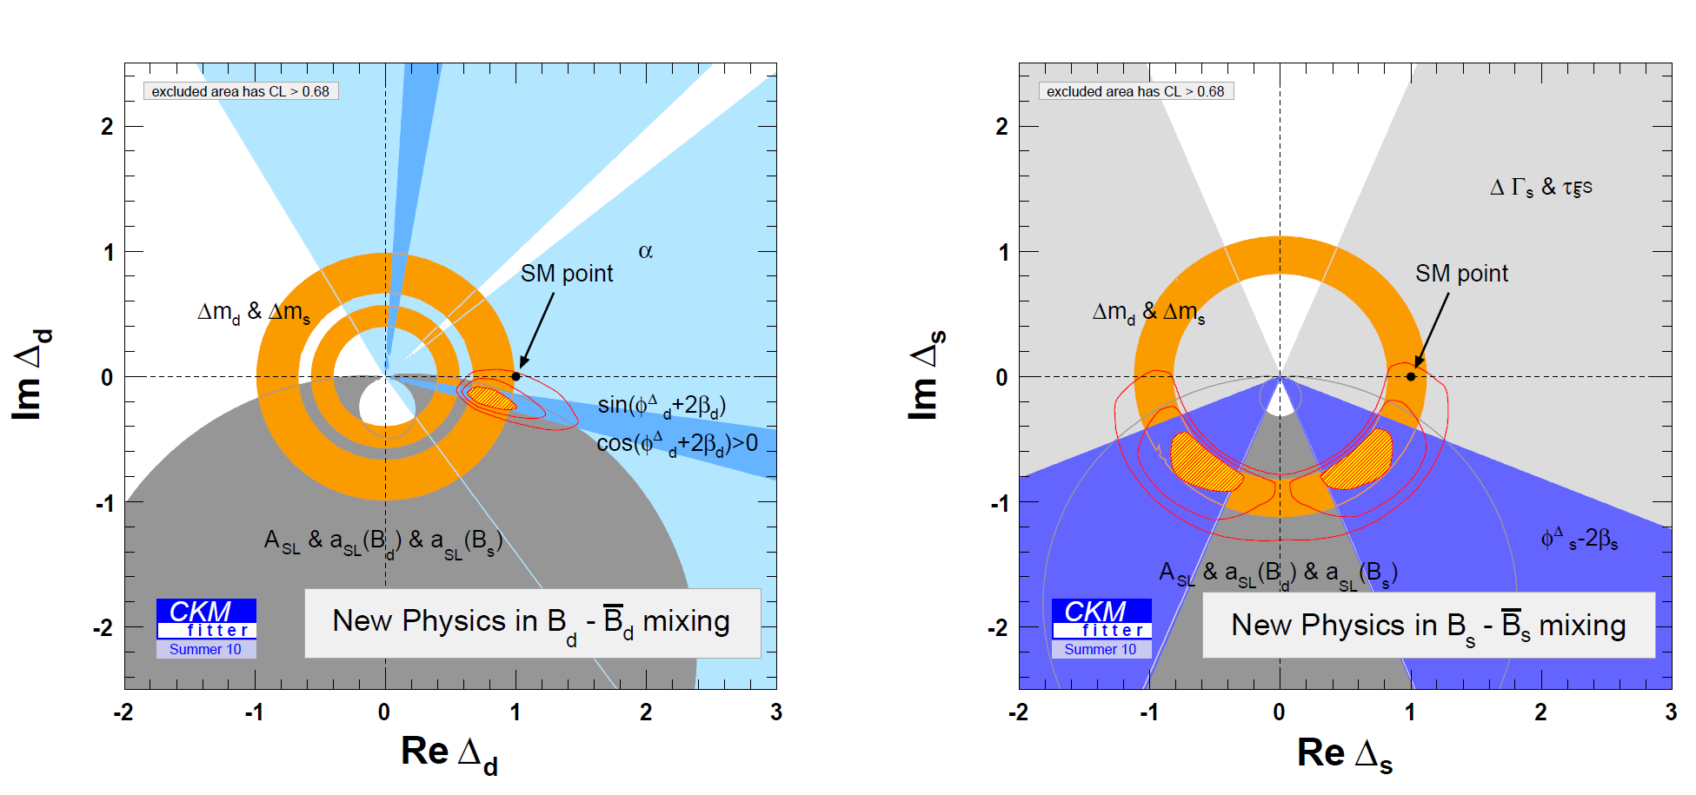
Status: NP in mixing?
SM is disfavoured by 3.6σ
Owing a lot to the recent D∅ measurement

Slide 25
Flavour-specific asymmetry
… a smoking gun for new physics??

Slide 26
Surprise!
…

Slide 27
Translate
Very difficult measurement
Observe
Flavour-specific asymmetry from B⁰-mixing in the SM:
In the standard model a_{fs} is almost negligible
≠
ν
μ⁻
b
c
b
CP asymmetry in mixing, a_{fs}
c
b
ν
μ⁻
∅
Notes:
Lenz, Nierste, hep-ph 1102.4274v1

Slide 28
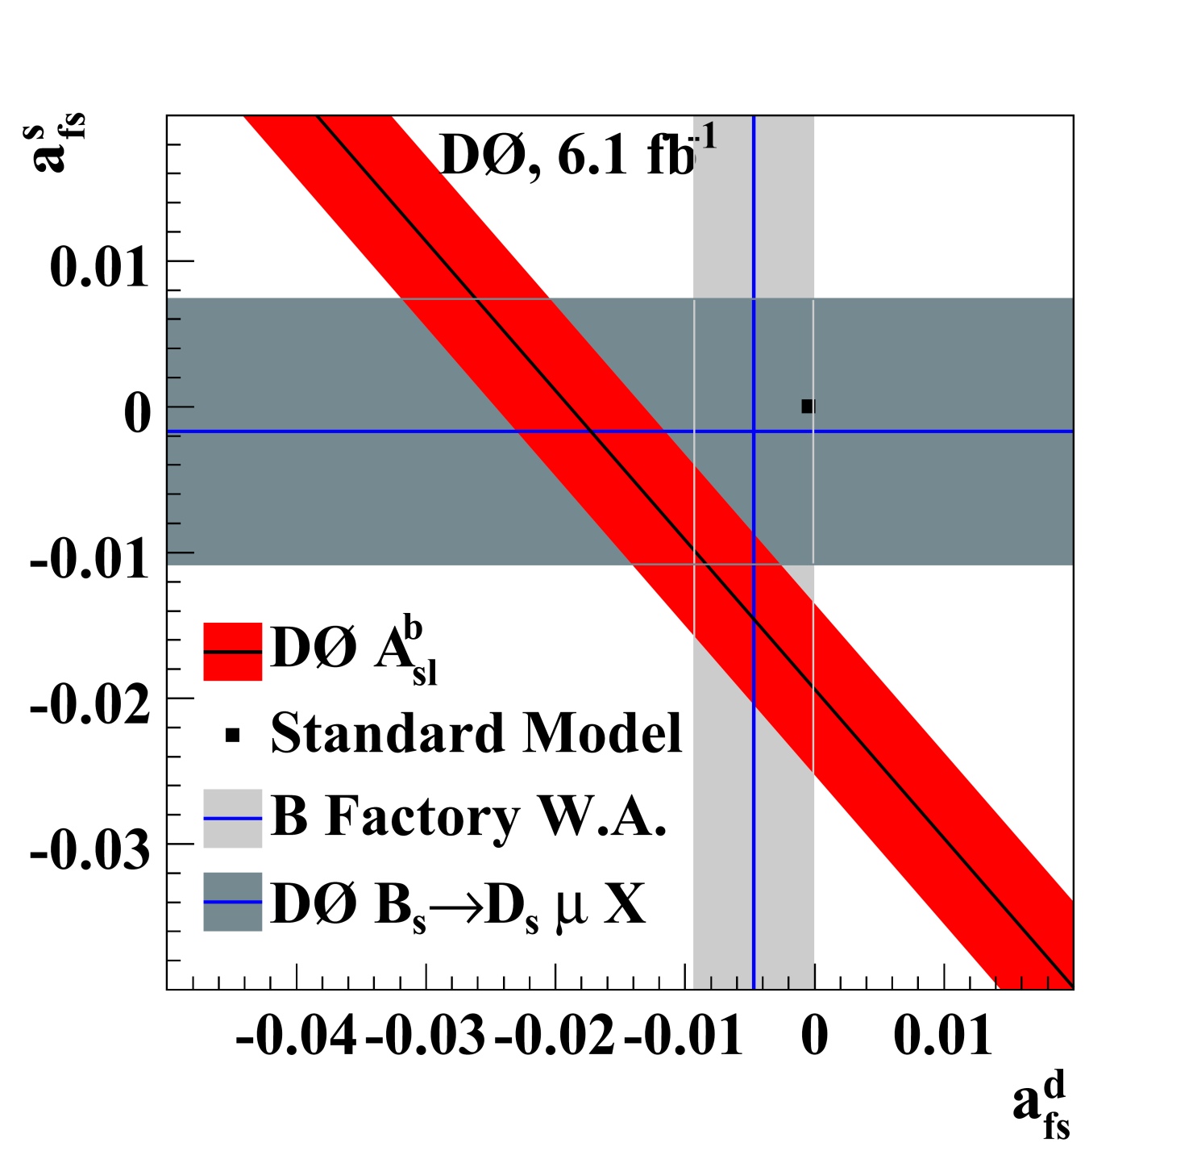
Hot Topic
Situation could really be cleared up by LHCb

Slide 29
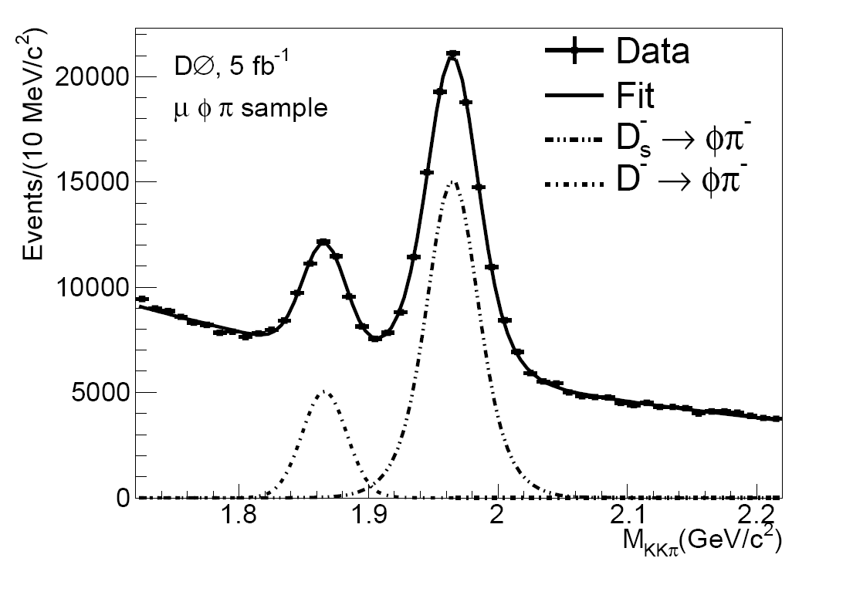
Current status
LHCb is reconstructing both and
LHCb is catching up with D∅ very quickly
~100k D_{s} in 5 fb⁻¹
~100k D_{s} in 0.2 fb⁻¹

Slide 30
Experimental Challenge
LHC is a pp-collider, not a pp-collider
LHCb is in the forward region
Can’t measure the same thing as D∅
Need a clever new method
Subtract two asymmetries to eliminate systematics
NB: D∅
(inclusive)
LHCb
(subtraction)

Slide 31
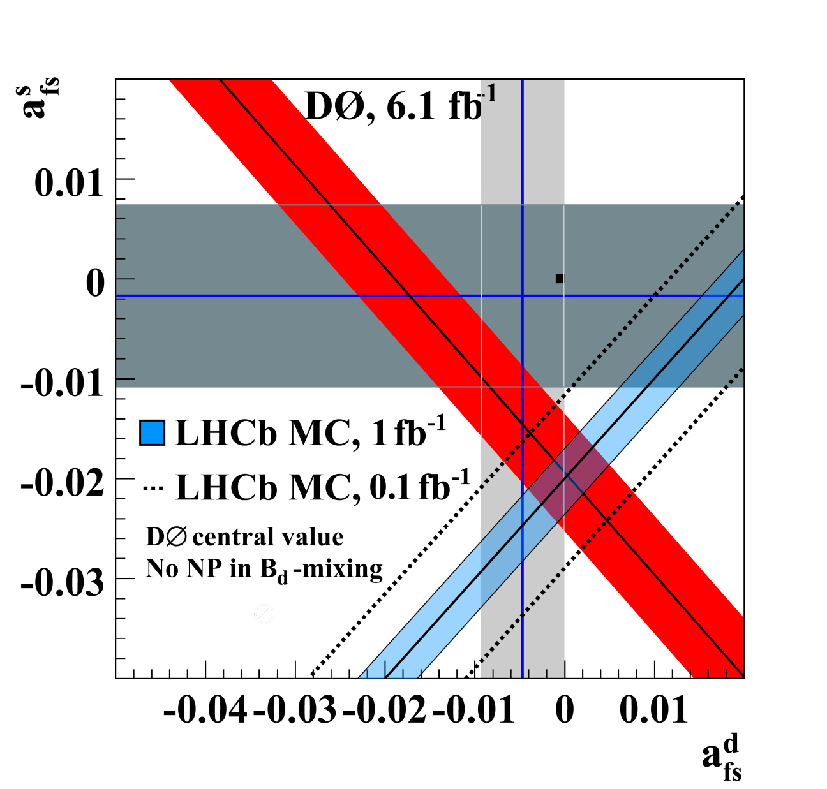
After 1fb⁻¹ of LHCb
LHCb measurement cuts at right-angles to D∅
Only one example of the great physics on the way from LHCb
Notes:
Add explanation to the slide here

Slide 32
Summary
Need new physics to explain the observed universe
LHC is a discovery machine
Precision measurements complement direct searches
LHCb is the flavour experiment at the LHC
B→Kπ, CKM-angle γ, B_{s/d}→μμ, B_{d}→K*μμ, B_{s}→J/ψΦ ...
We’ve seen a hint of new physics already from D∅
LHCb will make an early complementary measurement
This is only the start of the LHC era, so ....
Stay tuned for the latest experimental results!

Slide 33
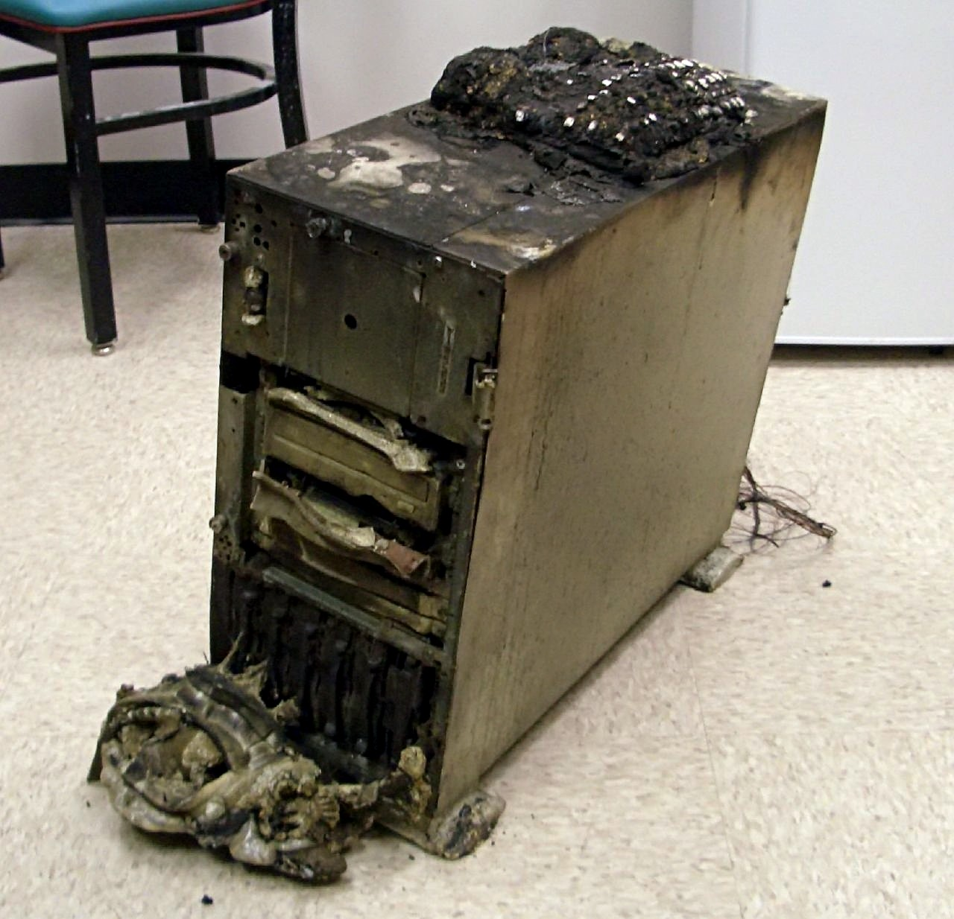
End
Backups are often required

Slide 34
Acknowledgements
Ulrich Kerzel for discussions on two-body B-decays
Guy Wilkinson and Thomas Ruf for their great advice
Johannes Albrecht for discussions on B_{s}→μμ
The CKM-fitter members of LHCb for updating the β_{s} plot, pointing out to me a long-standing physics goof in our TDR and other publications, and for putting up with my crazy questions about their fitting methods

Slide 35
Further References
LHCb:
B_{s}→μμ first result: http://arxiv.org/abs/1103.2465
Detector paper: J. of Instrumentation (No. 3 pp. S08005P)
“Roadmap” of physics analyses: arXiv:0912.4179
Chapter 2: γ
Chapter 3: B → Kπ
Chapter 5: B_{s/d} → μμ
Chapter 6: K* μμ
ΔA_{fs} studies:
R.W. Lambert, CERN-THESIS-2009-001
N. Brook et al., CERN-LHCb-2007-054
CPLear: Kaon mixing: Physics Reports, Volume 374, Issue 3, Pages 165-270 (January 2003)
Experimental averages:
CKM fitter group : http://ckmfitter.in2p3.fr/
HFAG (B →Kπ): http://www.slac.stanford.edu/xorg/hfag/rare/ichep10/acp/index.html
More on B→Kπ
Theory Status: S. Mishima from CKM 2010, arXiv:1101.1501
New Physics : S. Baek et al., arXiv:hep-ph/0412086
CDF B_{s/d} → μμ : CDF Public Note 9892 (preliminary)

Slide 36
Further introduction

Slide 37
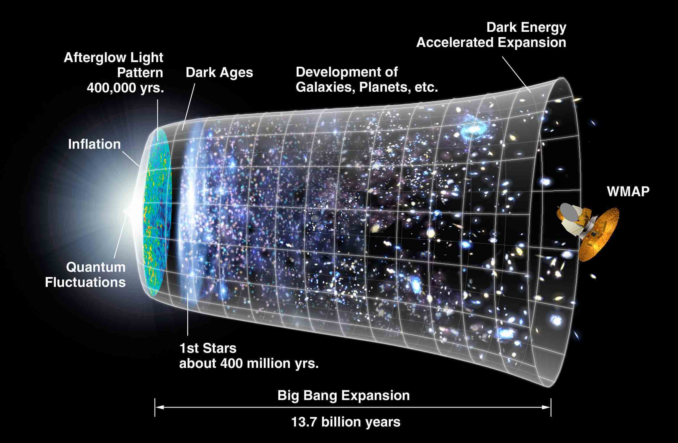
Gravity
(13.75 ± 0.13) Gyr
Notes:
Just last month, the WMAP collaboration had published the full analysis of their 7-year sky survey, and I couldn’t give a general talk in any conference without first acknowledging their results, and reminding you why it is so amazing.

Slide 38
Antimatter
Matter + Antimatter = photons
± CP-violation, CPV
observable difference between matter and antimatter
REALITY
SM (maximal CPV)
Mass of entire solar system: 2x10³⁰ kg
Mass of largest asteroid, Ceres: 10²¹ kg
Area ~ Kazakhstan: Population~one small dog

Slide 39
CKM and CPV
CPV in the SM is ensconced in a single unitary matrix
The phase is most readily observed in the b-quark system
The CKM matrix
Three real parameters
One complex phase violates CP

Slide 40
Unitarity Triangles
Product of rows and columns are constrained by unitarity
Of the nine relationships, six form a unitarity triangle
The most well-known triangle is:

Slide 41
CKM - status
Couplings, rates and mixings constrain magnitudes
Asymmetries and mixings constrain phases

Slide 42
Mixing observables

Slide 43
QM 101
The most basic hamiltonian of anything
Because:
Wave-like propagation
Decay

Slide 44
Mixing
It’s weird, it’s confusing… it must be quantum mechanics
In the b-system, for example, we have two coupled states
Simplest one-line hamiltonian is now a matrix
Off-diagonal elements provide mixing and interference
q
q
?
q
q

Slide 45
Mass-decay
So, it’s not a diagonal matrix… OK
let’s diagonalize it to find:
Not the flavour states, a time-dependent mixture of them!
These are the mass-decay-eigenstates

Slide 46
Observables
Four simple observables:
Average width
Average mass
Width Difference
Mass Difference
And we also have a phase, which violates CP:
All very predictable observables in the SM
and/or

Slide 47
Flavour-specific asymmetry
… a smoking gun for new physics??

Slide 48
Translate
pp-interactions within a symmetric experiment
Correct all experimental biases (magnets, mis-id …)
Observe
In the SM, the favoured way to make charge asymmetry is if:
Which comes from B⁰-mixing:
In the standard model it is almost negligible
≠
≠
≠
∅
Notes:
Lenz, Nierste, hep-ph 1102.4274v1

Slide 49
Discovery Potential
a_{fs} is very sensitive to new physics (NP) even if:
Tree-level processes are SM-dominated
SM flavour structure
Unitary CKM
With very weird scenarios (like leptoquarks)
Probe NP mixing, interference and/or decays
Usual formula is modified:

Slide 50
Discovery Potential
a_{fs} is very sensitive to new physics (NP) even if:
Tree-level processes are SM-dominated
SM flavour structure
Unitary CKM
With very weird scenarios (like leptoquarks)
Probe NP mixing, interference and/or decays
If we allow a single NP phase in the mixing Θ

Slide 51
Discovery Potential
a_{fs} is very sensitive to new physics (NP) even if:
Tree-level processes are SM-dominated
SM flavour structure
Unitary CKM
With very weird scenarios (like leptoquarks)
Probe NP mixing, interference and/or decays
If we allow a single NP phase in the mixing Θ
(first part is just the SM value)

Slide 52
Discovery Potential
a_{fs} is very sensitive to new physics (NP) even if:
Tree-level processes are SM-dominated
SM flavour structure
Unitary CKM
With very weird scenarios (like leptoquarks)
Probe NP mixing, interference and/or decays
If we allow a single NP phase in the mixing Θ
(first part is just the SM value)
Up to 200-times the SM!!! [[[ ... still... < D∅ measurement ]]]

Slide 53
Flavour-specific asymmetry
At LHCb

Slide 54
Experimental Challenge
At the LHC we have extra complications in the measurement
Polluting asymmetries, which are all much larger than a_{fs}
Production asymmetry δ_{p} ~(10⁻²)
Detector asymmetry δ_{c} ~(10⁻²)
Background asymmetry δ_{b} ~(10⁻³)
Use a, time-dependent, untagged, simultaneous fit to B_{s}+B_{d}
Subtract two asymmetries to eliminate detector component

Slide 55
Experimental Challenge
At the LHC we have extra complications in the measurement
Polluting asymmetries, which are all much larger than a_{fs}
Production asymmetry δ_{p} ~(10⁻²)
Detector asymmetry δ_{c} ~(10⁻²)
Background asymmetry δ_{b} ~(10⁻³)
Use a, time-dependent, untagged, simultaneous fit to B_{s}+B_{d}
Subtract two asymmetries to eliminate detector component
NB: D∅

Slide 56
The simple formula
10⁻³ -> 10 ⁻⁵

Slide 57
The simple formula
Very Complicated
Polluting asymmetries are much larger than a_{fs}
Detector asymmetry δ_{c} ~(10⁻²)
Production asymmetry δ_{p} ~(10⁻²)
Background asymmetry δ_{b} ~(10⁻³)
10⁻³ -> 10 ⁻⁵
10 ⁻²
10 ⁻²
10 ⁻³

Slide 58
Simplify
We measure time-dependent decay rates:
A_{c}, A_{p} and A_{fs} are correlated and cannot be separately fitted
First, reparameterise

Slide 59
Reparameterise
Just to make it easier to see what we’re doing…
production asymmetry is an initial state asymmetry
Changes the mixing amplitude, does not change the physics
Fit for x₁ independently, which now only has detector asym

Slide 60
The subtraction method
Take B_{s}/B_{d} with the same final states ( =KKπ μ)
All production asymmetry is in x₂/x₃, just throw it away
Measure the difference between B_{s} and B_{d}

Slide 61
Projections
MC sensitivities, Real data yields and systematics
0.1 fb⁻¹ σ~5x10⁻³ ... First result (2011)
1.0 fb⁻¹ σ~2x10⁻³ ... 5σ observation? (2012/2013)

Slide 62
LHCb projections

Slide 63
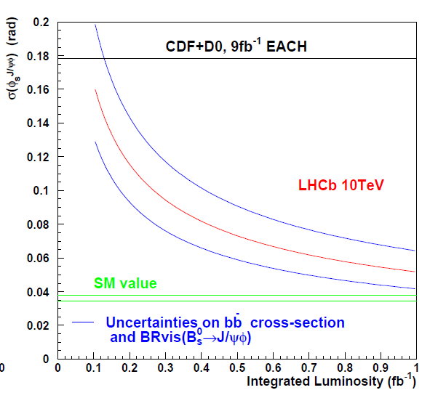
J/ψ Φ
LHCb MC!

Slide 64
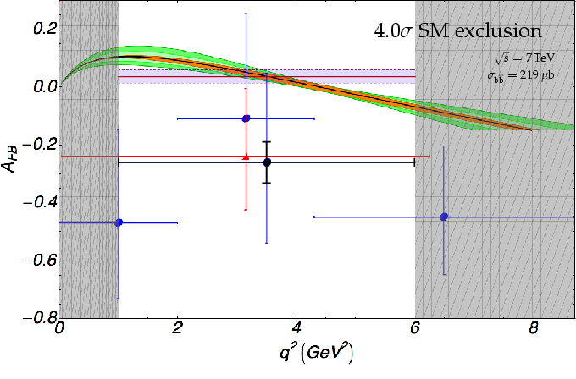
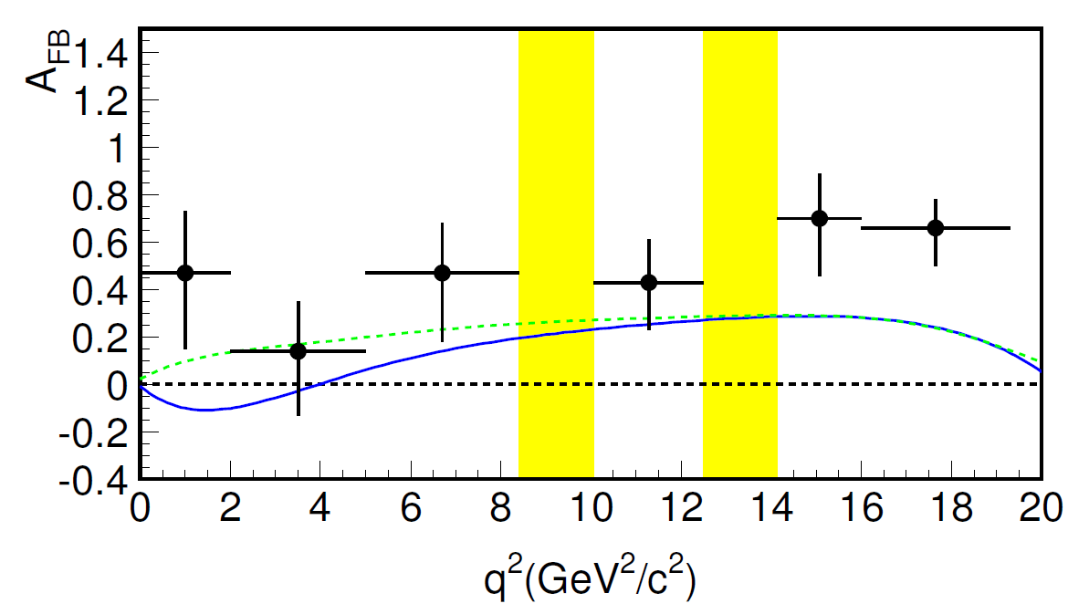
K*μμ
LHCb MC 1fb⁻¹
BaBar
657M bb-pairs

Slide 65
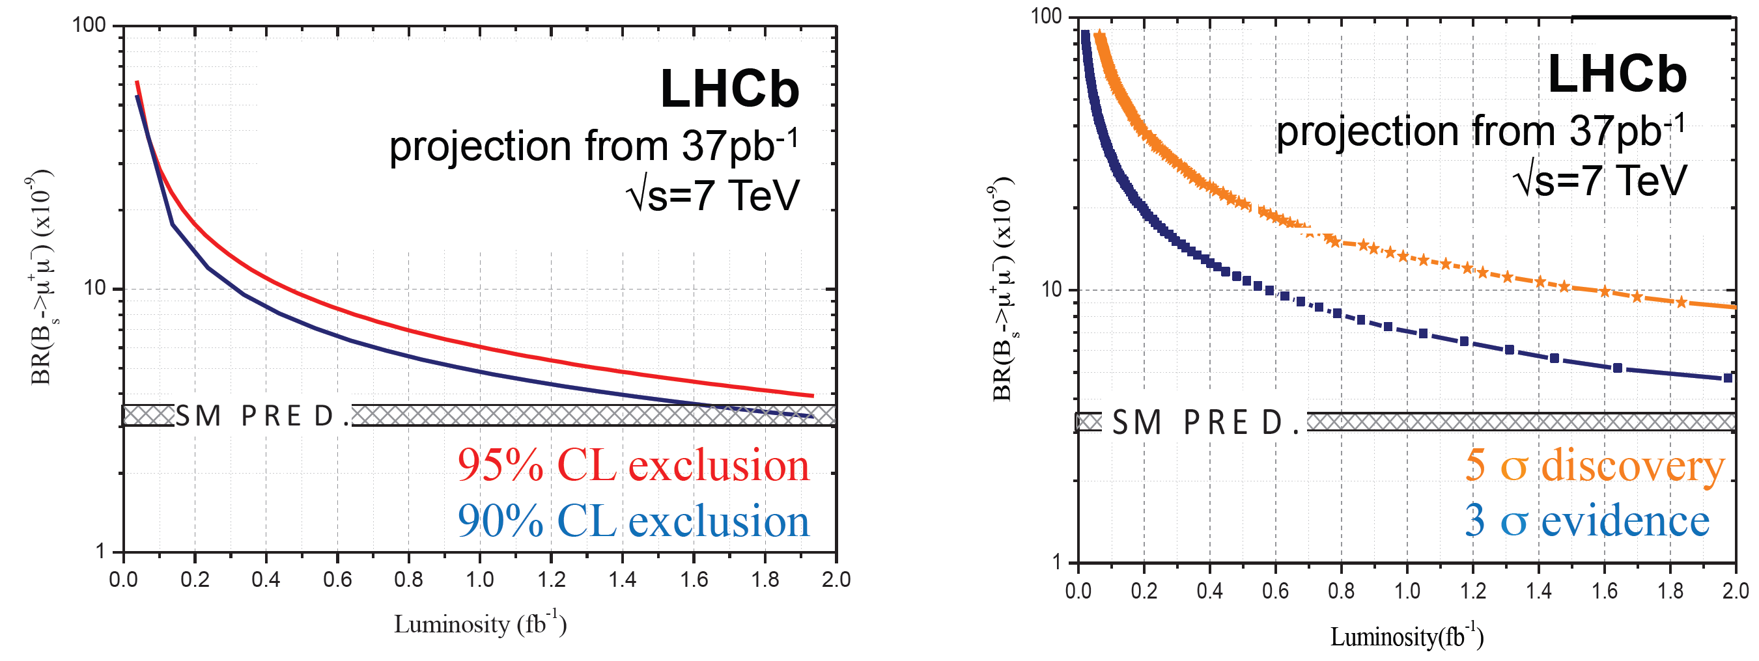
μμ
LHCb will exclude most SUSY models this year!

Slide 66
Misc

Slide 67
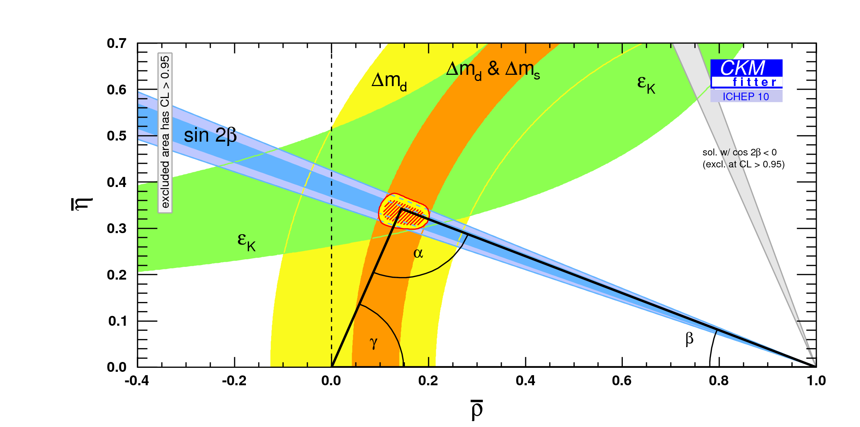
Looking for flavour (3)
Check loop-level observables
Would need a very accurate determination of dmd/dms

Slide 68
c.f. J/Ψ Φ
Directly Measure sin φ_{s}
σ(φ_{s}) = 0.05^{c} in 1 fb⁻¹
Effectively Measures
σ(Θ) = 0.5^{c} in 1 fb⁻¹
But they constrain NP differently
Effective power enhanced
NB physical limit of a_{fs} is at 4x10⁻³ < current D∅ result!

